Slide 1
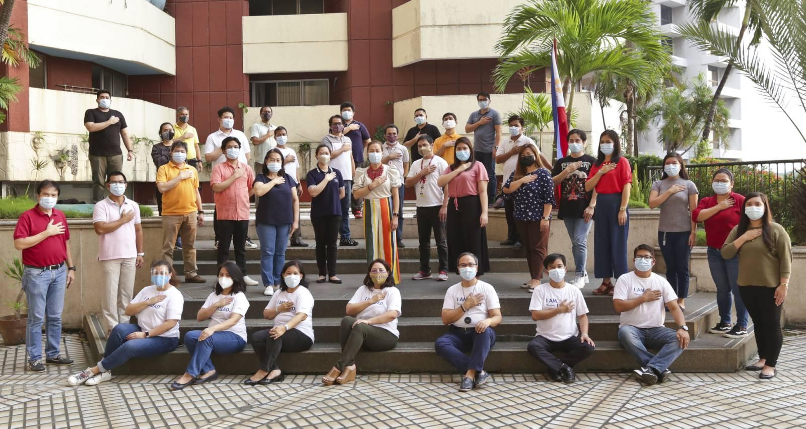

CITIZEN’S CHARTER
2021 Edition
November 2021

Slide 2
Agency Profile
I. Mandate
The TPB shall be responsible for marketing and promoting the Philippines domestically and internationally as a major global tourism destination, highlighting the uniqueness and assisting the development of its tourism products and services, with the end in view of increasing tourist arrivals and tourism investment. Specifically, it shall market the Philippines as a major convention destination in Asia.

Slide 3
Agency Profile
I. Mandate
To this end, it shall take charge of attracting, promoting, facilitating, and servicing large-scale events, international fairs and conventions, congresses, sports competitions, expositions and the like. It shall likewise ensure the regular advertisement abroad of the country’s major tourism destinations and other tourism products, not limited to TEZs. It may also provide incentives to travel agencies abroad which are able to draw tourists and tourism investments to the country.

Slide 4


Slide 5

IV. Service Pledge:
We, the officials and employees of the Tourism Promotions Board commit to demonstrate and uphold the following organizational values:

Slide 6


Slide 7
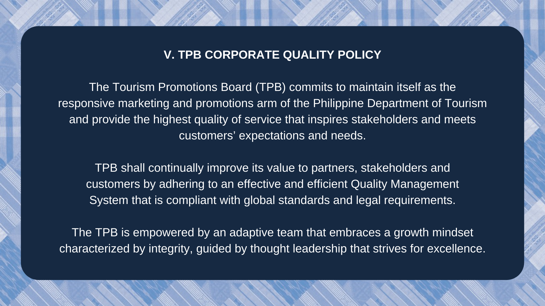

Slide 8
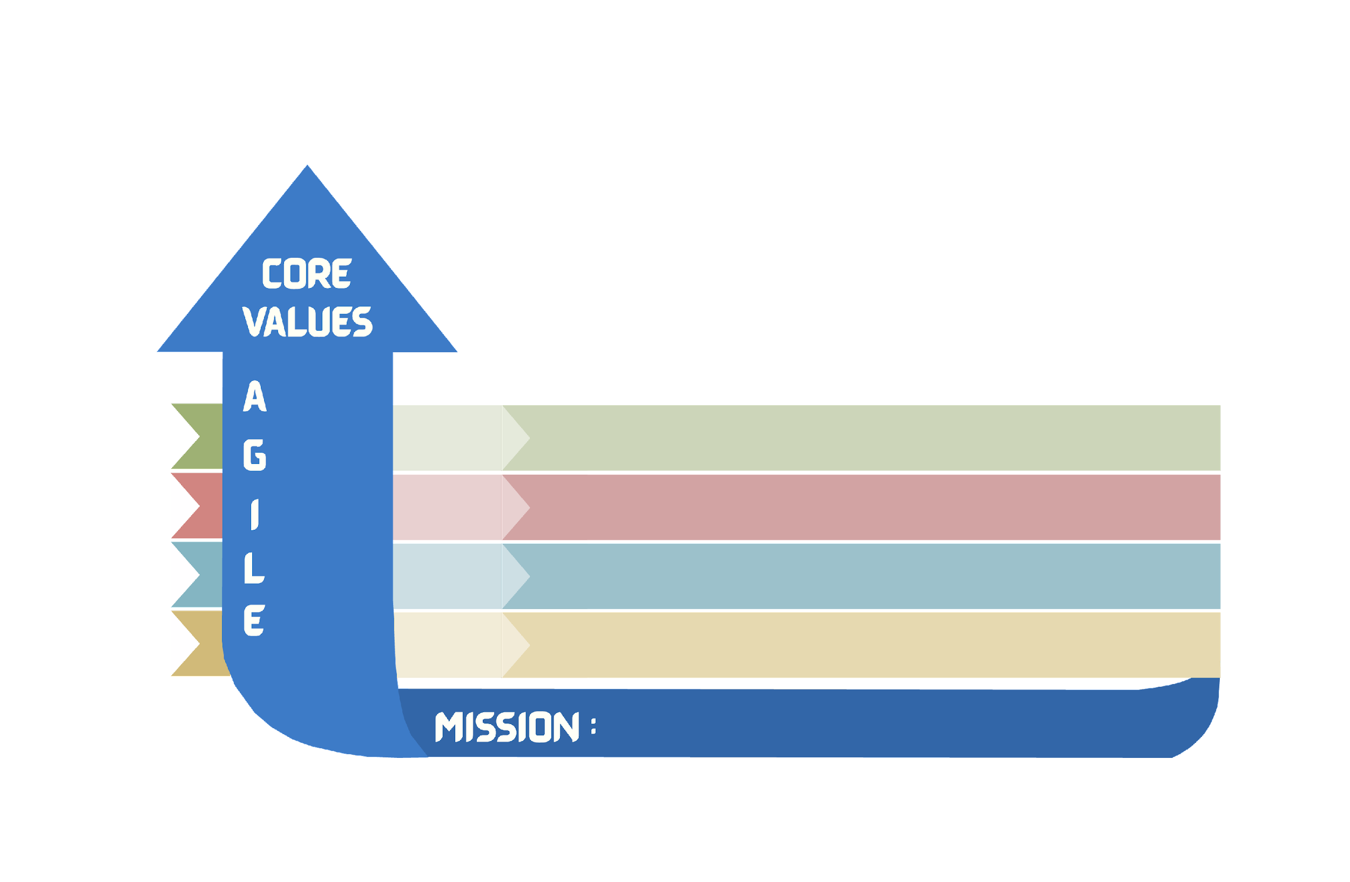

VISION: By 2028, the Philippines will be the preferred destination for sustainable, uniquely diverse, and fun travel.
SMARTourism
Partnership as Pathways
Safe Bangon Turismo
DAPTABILITY
CUSTOMER
Optimize the use of technology to implement innovative marketing and promotions programs.
Strengthen partnerships with stakeholders and customers.
Improve Customer Satisfaction
ROWTH
FINANCE
Ensure availability on the sources of funds of TPB
Manage efficiently the utilization of TPB funds
Develop business opportunities for TPB as possible revenue streams
NTEGRITY
Organizational Effectiveness & Good Governance
EADERSHIP
INTERNAL PROCESS
Ensure responsive administrative processes and systems
Maintain efficient, accountable and transparent risk-based processes and systems compliant to internal rules and legal requirements
XCELLENCE
LEARNING
& GROWTH
Sustain a culture of organizational engagement that fosters effective performance, lifelong learning, and growth
Cultivate an agile, empowered workforce for optimized operations
To market and promote the Philippines, in partnership with our stakeholders, towards a dynamic tourism destination
Notes:
TO MARKET AND PROMOTE THE PHILIPPINES, IN PARTNERSHIP WITH OUR STAKEHOLDERS, TOWARDS A DYNAMIC TOURISM DESTINATION

Slide 9
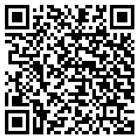
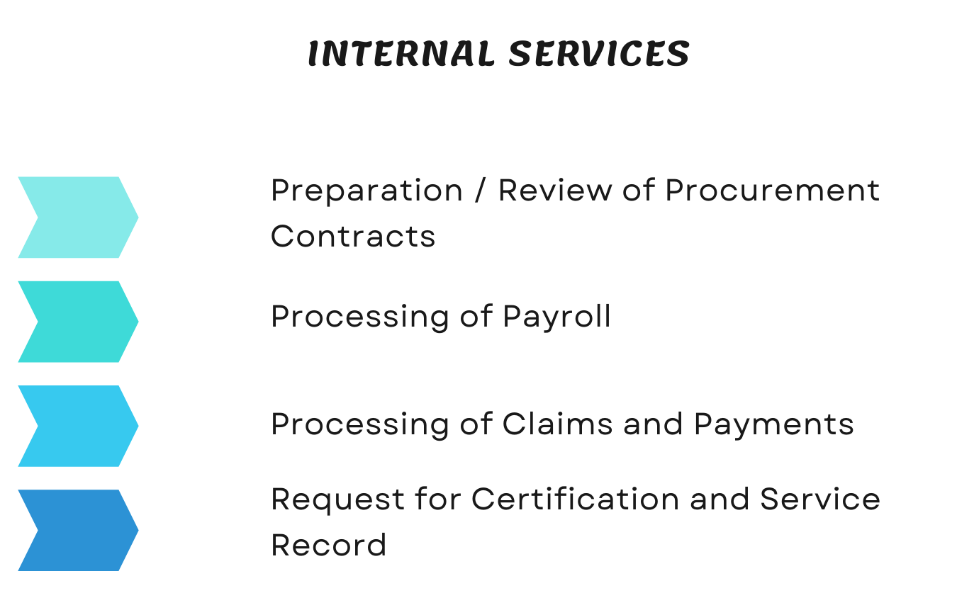

Slide 10
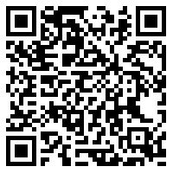
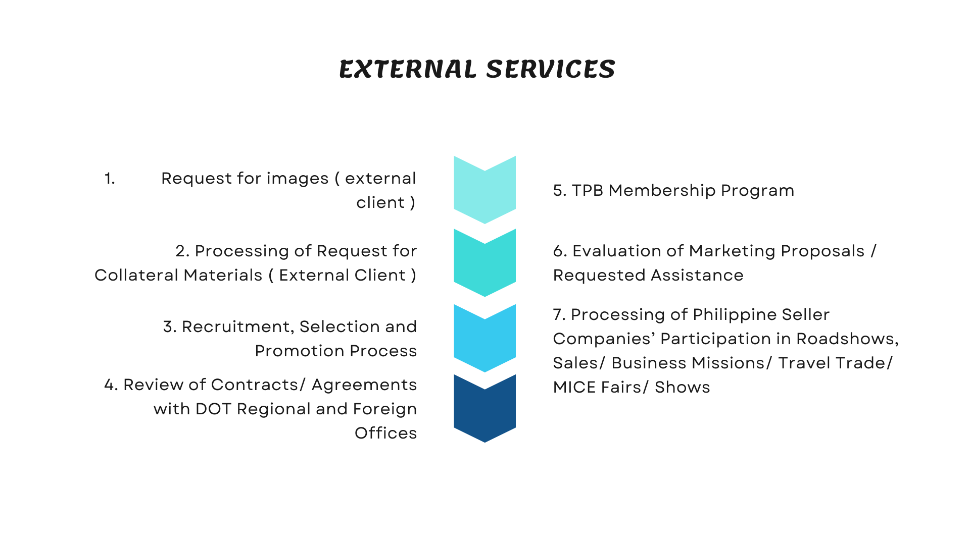

Slide 11

INTERNAL SERVICES

Slide 12
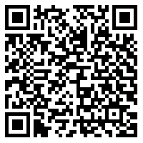
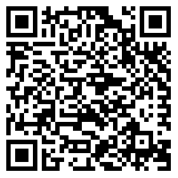
INTERNAL SERVICES
PREPARATION/ REVIEW OF PROCUREMENT CONTRACTS
Process
Citizen’s Charter

Slide 13
1. Preparation/ Review of Procurement Contracts
To prepare/review Procurement Contracts/Agreements within a period of seven (7) working days upon receipt of request supported by complete documents from the Requesting Department up to the release of reviewed contract or agreement for execution, of TPB projects requiring the execution of Contracts and Agreements arising from procurement related transactions.
Office or Division: | Legal Department
Classification: | Highly Technical Support/Complex
Type of Transaction: | G2G - Government to Government
Who may avail: | BAC Secretariat/ Procurement Division

Slide 14
1. Preparation/ Review of Procurement Contracts
CHECKLIST OF REQUIREMENTS | WHERE TO SECURE
A. Goods ● Bidding Documents ● Minutes of Proceedings ● Supplemental Bid Bulletin, if any ● Bid Evaluation ● Post-Qualification Report ● BAC Resolution Awarding the Contract ● Notice of Award with Bidder's Conforme ● Performance Security ● Other contract documents that may be required by existing laws and/or the Entity | To be submitted by the Requesting Department

Slide 15
1. Preparation/ Review of Procurement Contracts
CHECKLIST OF REQUIREMENTS | WHERE TO SECURE
B. Consulting Services ● Bidding Documents ● Minutes of Proceedings ● Supplemental Bid Bulletin, if any ● Result of Shortlisting ● Bid Evaluation ● Minutes of the Negotiation signed by BAC, BAC Secretariat, TWG, End User,if any ● Post-Qualification Report ● BAC Resolution Awarding the Contract ● Notice of Award with Bidder's Conforme ● Performance Security

Slide 16
1. Preparation/ Review of Procurement Contracts
CHECKLIST OF REQUIREMENTS | WHERE TO SECURE
C. Infrastructure ● General and Special Conditions of Contract ● Drawings/Plans ● Specifications ● Invitation to Bid ● Instructions to Bidders ● Bid Data Sheet ● Addenda and/or Supplemental/ Bid Bulletin, if any ● Bid Form, including all the documents/ statements contained in the Bidder's bidding envelopes, as annexes Eligibility requirements, documents and/or statements ● Performance Security ● Credit line issued by a licensed bank, if any ● Notice of Award with Bidder's Conforme ● Other contract documents that may be required by existing laws and/or the Entity

Slide 17
1. Preparation/ Review of Procurement Contracts
CHECKLIST OF REQUIREMENTS | WHERE TO SECURE
D. Alternative Modes of Procurement ● Bidding Documents, if any ● List of Pre-selected suppliers, if applicable ● Request for Quotation, if applicable Eligibility Documents of the bidder/ supplier ● Market survey, if applicable ● Certificate or proof of proprietary ownership, if applicable ● Certificate of exclusive dealership or distributorship, if applicable ● Certificate of previously awarded from previous bidding, if applicable ● BAC Resolution Awarding the Contract ● Bid evaluation/ Quotation Evaluation Form/ Abstract of Bids, if applicable ● Performance Security, if applicable ● Other contract documents that may be required by existing laws and/or the Entity

Slide 18
1. Preparation/ Review of Procurement Contracts
CHECKLIST OF REQUIREMENTS | WHERE TO SECURE
E. Negotiated Procurement ● Bidding Documents, if any ● Request for Quotation, if applicable ● Eligibility Documents of the bidder/ supplier ● Comparative Market Analysis, if applicable ● Market Study, if applicable ● BAC Resolution Declaring Failure of Bidding, if applicable ● BAC Resolution Awarding the Contract ● Bidder's Technical and Financial Requirements, if applicable

Slide 19
1. Preparation/ Review of Procurement Contracts
CHECKLIST OF REQUIREMENTS | WHERE TO SECURE
●Determination of HOPE as to existence of Emergency or Declaration of State of Calamity, if applicable ● Rescinded Contract, if applicable ● Negotiated Terms of Reference for Adjacent Procurement, if applicable ● Justification of engagement with individual Highly Technical Consultants ● Bid Evaluation/ quotation Evaluation Form/ Abstract of Bids/ Quotation/Ratings, if applicable ● Performance Security, if applicable Other contract documents that may be required by existing laws and/or the Entity

Slide 20
1. Preparation/ Review of Procurement Contracts
CLIENT STEPS | AGENCY ACTIONS | FEES TO BE PAID | PROCESSING TIME | PERSON RESPONSIBLE
1. Submit request form for the Preparation/Review of Procurement Contracts and supporting documents. | 1.1 Stamp receipt, check supporting documents and record entries. 1.2 Assign the request to the Lawyer/Legal Researcher/Legal Staff. 1.3 Review the draft Contract Agreement and prepare the initial draft, if warranted. 1.4 Review the initial draft of the Contract Agreement. | None | Within 3 hours from receipt Within 4 – 5 hours from receipt of documents (1 day) Within 2 working days from receipt of documents Within 2 working days from receipt of documents | Legal Assistant Department Head or OIC Assigned Lawyer/Legal Researcher/Legal Staff Department Head or OIC

Slide 21
1. Preparation/ Review of Procurement Contracts
CLIENT STEPS | AGENCY ACTIONS | FEES TO BE PAID | PROCESSING TIME | PERSON RESPONSIBLE
 | 1.5 Release the initial draft of the Contract Agreement/ the recommendation or opinion to the Requesting Department. |  | Within 3 hours from receipt of documents | Legal Assistant
2. Receive the draft Contract/Agreement for second/final review. | 2.1 Stamp receipt, check supporting documents and record entries. 2.2 Conduct Second or Final Review of the draft Contract/ Agreement or Evaluate and review the Memorandum or Letter for Reconsideration from the Requesting Department. 2.3 Finalization and Release of the proposed Contract/Agreement for Execution. | None | Within 3 hours from receipt of documents Within 1 working day from receipt of documents Within 1 working day from receipt of confirmation | Legal Assistant Department Head or OIC/ Assigned Lawyer/Legal Researcher/Legal Staff Department Head or OIC/ Assigned Lawyer/Legal Researcher/Legal Assistant

Slide 22
1. Preparation/ Review of Procurement Contracts
CLIENT STEPS | AGENCY ACTIONS | FEES TO BE PAID | PROCESSING TIME | PERSON RESPONSIBLE
3. Submission of Notarized Copies of Contract/Agreement by the Requesting Department | 3.1 Stamp receipt the Notarized Copies of Contract/ Agreement prior to the implementation of the Project. 3.2 File Records. | None | Within 2 hours upon receipt | Legal Assistant

Slide 23
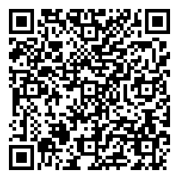
INTERNAL SERVICES
PROCESSING OF PAYROLL
Process
Citizen’s Charter

Slide 24
2. Processing of Payroll
Office or Division: | Personnel and Human Resources
Classification: | Simple
Type of Transaction: | G2G - Government to Government
Who may avail: | TPB Personnel
CHECKLIST OF REQUIREMENTS |  | WHERE TO SECURE
In payroll processing reference only: ● Application for Leave Form ● Official Business Pass ● Office/Travel Order ● List of Mandatory Deductions ● List of Loans from Accredited Institutions ● Leave Cards

Slide 25
2. Processing of Payroll
This service defines the standard process of payroll preparation to ensure timely and accurate computation of salaries and deductions. It covers from the receipt of approved DTR with required supporting documents up to submission of approved payroll to the servicing bank. The classification of service is considered simple since the total processing time is not exceeding the maximum periods of three (3) days.
CLIENT STEPS | AGENCY ACTIONS | FEES TO BE PAID | PROCESSING TIME | PERSON RESPONSIBLE
1. Receive Approved Daily Time Records (DTRs) | 1.1 Receive approved Daily Time Records (DTRs) within 10 working days of the following month. 1.2 If there is no entry in the DTR, check if the following are submitted: Application for Leave Form For Regular Employees ● (CSC Form No. 6) | None | 4 hours | PHRD Staff

Slide 26
2. Processing of Payroll
CLIENT STEPS | AGENCY ACTIONS | FEES TO BE PAID | PROCESSING TIME | PERSON RESPONSIBLE
 | For Contractual Employees (QF-PHRD-18) ● Official Business Pass (QF-PHRD-19) ● Office / Travel Order 1.3 Check if there are available leave credits.
1. Determine applicable deductions | ● 2.1 Determine applicable deductions, i.e., leave without pay, loans and insurance, based on the payroll system deduction/ loan scheduler | None | 4 hours | HRMO

Slide 27
2. Processing of Payroll
CLIENT STEPS | AGENCY ACTIONS | FEES TO BE PAID | PROCESSING TIME | PERSON RESPONSIBLE
3. Determine AWOP/LWOP | 3.1 Action officer to ensure the copy furnished of AWOP/ LWOP to payroll officer. | None | 1 hour | PHRD Staff
4. Input deductions to the Payroll System | 4.1 Input personal deductions to the Payroll System. Ensure accuracy of entries. 4.2 Update mandatory deductions as needed. | None | 4 hours | HRMO

Slide 28
2. Processing of Payroll
CLIENT STEPS | AGENCY ACTIONS | FEES TO BE PAID | PROCESSING TIME | PERSON RESPONSIBLE
5. Compute Allowances | 5.1 Compute Allowances based on the DTRs/Office Orders. | None | 2 hours | HRMO
6. Print Payroll Sheet | 6.1 Print Basic Salary and Allowance Payroll Sheet. | None | 15 mins | HRMO
7. Prepare BURS, DV and Transmittal Letter to the Bank | 7.1 Prepare Budget Utilization and Report Slip (BURS), Disbursement Voucher (DV) and Transmittal Letter to the Bank for the payroll. | None | 15 mins | HRMO

Slide 29
2. Processing of Payroll
CLIENT STEPS | AGENCY ACTIONS | FEES TO BE PAID | PROCESSING TIME | PERSON RESPONSIBLE
8. Approval of Basic Salary and Allowance Payroll Sheet, BURS, and Land Bank payroll register as attachments on Transmittal Letter to the Bank | 8.1 Affix initial by the HRMO 8.2 Affix signature by the Division Chief 8.3 Forward to the Administrative Head for signature | None | 10 mins | HRMO Division Chief Administrative Head
9. Forward Payroll Sheet, BURS and DV | 9.1 Forward to Finance Department the following for processing: ● Basic Salary and Allowance Payroll Sheet ● Budget Utilization and Report Slip (BURS) | None | 10 mins | HRMO

Slide 30
2. Processing of Payroll
CLIENT STEPS | AGENCY ACTIONS | FEES TO BE PAID | PROCESSING TIME | PERSON RESPONSIBLE
 | ● Disbursement Voucher (DV) ● Transmittal Letter to the Bank (refer to Finance Processing of Claims Procedure)
10. Receive approved Basic Salary and Allowance Payroll Sheet | 10.1 Receive approved Basic Salary and Allowance Payroll Sheet with approved Transmittal Letter to the Bank. | None | Within the day subject to the availability of the signatory | HRMO

Slide 31
2. Processing of Payroll
CLIENT STEPS | AGENCY ACTIONS | FEES TO BE PAID | PROCESSING TIME | PERSON RESPONSIBLE
11. Input Computed Individual Basic Salary and Allowance to Land Bank of the Philippines (LBP) Payroll System | 11.1 Input Computed Individual Basic Salary and Allowance to Land Bank of the Philippines (LBP) Payroll System. Ensure accuracy of entries. 11.2 Print Individual Basic Salary and Allowance Report for signature of Administrative Manager and Deputy COO for Corporate Affairs. | None | 1 hour | HRMO
12. Print Pay Slip | 12.1 Print Pay Slip for Basic Salary and Allowances. | None | 15 mins | HRMO

Slide 32
2. Processing of Payroll
CLIENT STEPS | AGENCY ACTIONS | FEES TO BE PAID | PROCESSING TIME | PERSON RESPONSIBLE
13. Submit Individual Basic Salary and Allowance Report to LBP | 13.1 Submit Individual Basic Salary and Allowance Report (hard and soft copy) to LBP with the Transmittal Letter. | None | 30 mins to 1 hour | PHRD Staff
14. File Records | 14.1 Retain all documented information in accordance with Control of Retained Documented Information Procedure and Masterlist of Retained Quality Documented Information. | None | Within the day upon receipt of complete documents | Deputy Documented Information Controller / Concerned Process Owner
TOTAL PROCESSING TIME |  |  | 2 days, 2 hours and 5 minutes

Slide 33
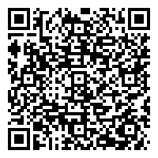
INTERNAL SERVICES
PROCESSING OF CLAIMS AND PAYMENTS
Process
Citizen’s Charter

Slide 34
3. PROCESS : PROCESSING OF CLAIMS AND PAYMENTS
Descriptions:
This process covers the timely review and evaluation of the financial claims as to completeness and reasonableness of the supporting documents, in order to facilitate the immediate settlement/payment of expenses incurred necessary in the successful implementation of TPB’s project, programs and activities.
Office or Division: | Finance Department- Accounting and Budget Division
Classification: | Highly Technical
Type of Transaction: | G2G. G2C and G2B External and Internal Customers – Financial
Who may avail: | Suppliers of Goods and Services including Infrastructure.

Slide 35
3. PROCESSING OF CLAIMS AND PAYMENTS
CHECKLIST OF REQUIREMENTS |  | WHERE TO SECURE
Google Drive QF Find 01 to 89 |  | At Finance Department- Accounting and Budget Division
CLIENT STEPS | AGENCY ACTIONS | FEES TO BE PAID | PROCESSING TIME | PERSON RESPONSIBLE
Submit Statement of Account (SOA) and/or other required complete documents to Functional Groups/Departments/Divisions who availed /purchase goods and services | Concerned functional Groups /Departments /Divisions prepare and submit the BURS and DV along with the SOA and/or other required complete documents to the Budget Division for budget allocation. | None | 1 hour | Concerned Project Officer/ Division Head/ End User

Slide 36
3. PROCESSING OF CLAIMS AND PAYMENTS
CLIENT STEPS | AGENCY ACTIONS | FEES TO BE PAID | PROCESSING TIME | PERSON RESPONSIBLE
 | The Budget Division verifies the existence of appropriation in the PPMP/COB and allocates the amount, by signing Box B of the BURS. | None | 2 hours | Budget Division Chief
 | The Budget Division forwards the signed BURS and other documents to the Accounting Division for processing of payment. | None | 2 working days | Budget Officer
 | The Accounting Division reviews and examines the DV as to validity, propriety, reasonableness of claims including the required signatories and completeness of supporting documents. | None | 2 hours | Financial Analyst

Slide 37
3. PROCESSING OF CLAIMS AND PAYMENTS
CLIENT STEPS | AGENCY ACTIONS | FEES TO BE PAID | PROCESSING TIME | PERSON RESPONSIBLE
 | 4. The Accounting Division fills-out DV details and prepares BIR Forms 2306 and 2307 | None | 2 hours | Financial Analyst
 | 5. The Authorized signatories sign the Box C & D of the DV. Fully signed DV is forwarded to the Cashier Unit for check/ADA preparation. | None | 5 working days | Finance Department Manager/ OIC Accounting Division Chief/OIC Manager/ Administrative Department DCOO/OIC for Corporate Affairs Chief Operating Officer/OIC Chairperson/ Alternate Signatory

Slide 38
3. PROCESSING OF CLAIMS AND PAYMENTS
CLIENT STEPS | AGENCY ACTIONS | FEES TO BE PAID | PROCESSING TIME | PERSON RESPONSIBLE
 | 6. The Cashier prepares Check/ ADA/ or ACIC. | None | 1 working day | Cashier
 | 7. The Authorized Signatories Approve/Countersign Checks/ADA | None | 6 working days | Manager/Administrative Department DCOO/OIC for Corporate Affairs Chief Operating Officer/OIC/Chairperson/Alternate Signatory
 | 8. The Cashier Unit releases the signed Checks to Claimants and remits the ADA/ACIC to the bank. | None | 1 hour | Cashier
TOTAL TIME |  |  | 15 working days

Slide 39
4. Request for Certification and Service Record
The Certification and Service Record are issued to employees needing these documents to affirm the validity of the employment information and state that there is no pending case filed against the requesting employee. The classification of service is considered simple since the processing time is within the day release of the requested document.
Office or Division: | Personnel and Human Resources Development Division (PHRDD)
Classification: | Simple
Type of Transaction: | G2G - Government to Government
Who may avail: | All active and former TPB employees

Slide 40
4. Request for Certification and Service Record
CHECKLIST OF REQUIREMENTS |  | WHERE TO SECURE
● Request for Certification / Service Record Form ● Office/Travel Order/Special Order |  | TPB ISO Quality Forms Google Drive Files
CLIENT STEPS | AGENCY ACTIONS | FEES TO BE PAID | PROCESSING TIME | PERSON RESPONSIBLE
1.Request for Certification and Service Record | 1.1 Requesting employees must fill-up a request for certification / service record form (QF-PHRD-21) and submit it to the PHRDD. For purposes of official travel abroad please attach a copy of the signed Travel or Special Order. | None | Within the day subject to the availability of the signatory | Requesting Employee

Slide 41
4. Request for Certification and Service Record
1.2 Requesting employees will be informed once the certification / service record has been signed by the PHRDD Division Chief and is ready for pick-up. |  |  | HRMO/ PHRD Staff
TOTAL PROCESSING TIME |  |  |  | 1 Day

Slide 42
EXTERNAL SERVICES

Slide 43
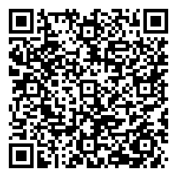
EXTERNAL SERVICES
PROCESSING OF REQUEST FOR IMAGES, VIDEOS, AND MULTIMEDIA
(EXTERNAL CLIENT)
Process
Citizen’s Charter

Slide 44
1. Processing of Request for Images, Videos, and Multimedia
(External Client)
To provide images, videos, and other multimedia products and materials to external clients (requesting party/ies) from TPB’s image databank based on specifications provided.
Office or Division: | Marketing Communications (MARCOM) Department Media Relations and Communications Division
Classification: | Simple
Type of Transaction: | G2C – Government to Citizen; G2B – Government to Business; and G2G – Government to Government
Who may avail: | Academe; Tour Operators; Private Sector; DOT Overseas Offices; National Government Agencies; Embassies; and other Industry Stakeholders

Slide 45
1. Processing of Request for Images, Videos, and Multimedia
(External Client)
CHECKLIST OF REQUIREMENTS |  | WHERE TO SECURE
Letter of Request with specific details on purpose, scope, confidentiality safeguards, among others. |  | To be submitted by the requesting party
Signed Letter of Authorization and Guidelines on the use of TPB assets |  | Form to be sent by Marketing Communications Department for signature of the requesting party
CLIENT STEPS | AGENCY ACTIONS | FEES TO BE PAID | PROCESSING TIME | PERSON RESPONSIBLE
1. Submit the Letter of Request | 1.1 Receive the Letter of Request. | None | 3 hours | Department Manager/Division Chief and /or MARCOM Secretary
 | 1.2 Send the tracking number to the requesting party. | None | 1 hour | MARCOM Project Officer/Personnel

Slide 46
1. Processing of Request for Images, Videos, and Multimedia
(External Client)
CLIENT STEPS | AGENCY ACTIONS | FEES TO BE PAID | PROCESSING TIME | PERSON RESPONSIBLE
 | 1.3 Endorses the request to the concerned MARCOM division upon approval of MARCOM Manager. | None | 1 hour | MARCOM Secretary
 | 1.4 Verify the multimedia resource/s requested. | None | 1 day | Image Bank Custodian
 | 1.5 Select the proposed multimedia resource/s. | None | 4 hours | Image Bank Custodian
 | 1.6 Prepare the selected multimedia resource/s, Letter of Authorization, and guidelines on the use of TPB’s assets. | None | 1 day | Image Bank Custodian

Slide 47
1. Processing of Request for Images, Videos, and Multimedia
(External Client)
CLIENT STEPS | AGENCY ACTIONS | FEES TO BE PAID | PROCESSING TIME | PERSON RESPONSIBLE
 | 1.7 Recommend for approval. | None | 4 hours | Department Manager/ Division Chief Deputy Chief Operating Officer- Marketing and
 | 1.8 Approve the requested images, Letter of Authorization, and guidelines on the use of TPB’s assets. | None | 2 days | Department Manager/ Division Chief Deputy Chief Operating Officer- Marketing and
 | 1.9 Send the Letter of Authorization to the requesting party. | None | 1 hour | MARCOM Secretary

Slide 48
1. Processing of Request for Images, Videos, and Multimedia
(External Client)
2. Receives, conforms and reverts the Letter of Authorization. | 2.1 Awaits for the conformed / signed guidelines | None | 2 hours | Image Bank Custodian
 | 2.2 Receives, reviews and acknowledges the conformed Letter of Authorization. | None | 1 hour | Image Bank Custodian
 | 2.3 Releases the requested images to requesting party | None | 2 hours | Image Bank Custodian MARCOM Secretary
TOTAL PROCESSING TIME |  |  | 6 days, 3 hours

Slide 49
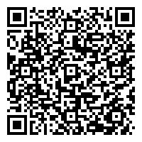
EXTERNAL SERVICES
PROCESSING OF REQUEST FOR COLLATERAL MATERIALS (EXTERNAL CLIENT)
Process
Citizen’s Charter

Slide 50
2. Processing of Request for Collateral Materials (External Client)
To provide collaterals to external clients (requesting party/ies) based on specifications provided and availability of materials.
Office or Division: | Marketing Communications (MARCOM) Department Brand Management and Advertising Division[1] [2]
Classification: | Simple
Type of Transaction: | G2C – Government to Citizen; G2B – Government to Business; and G2G – Government to Government
Who may avail: | DOT Regional and Overseas Offices; Embassies; Academe; National Government Agencies; Private Sector; and other Industry Stakeholders

Slide 51
2. Processing of Request for Collateral Materials (External Client)
CHECKLIST OF REQUIREMENTS | WHERE TO SECURE
Letter of Request: For Industry stakeholders: with valid Certificate of DOT Accreditation For Students: Letter of Request attested by College Dean | To be submitted by the requesting party
Property Gate Pass (IN/OUT) | To be provided by the Concerned MARCOM Project Officer / Personnel

Slide 52
2. Processing of Request for Collateral Materials (External Client)
CLIENT STEPS | AGENCY ACTIONS | FEES TO BE PAID | PROCESSING TIME | PERSON RESPONSIBLE
1. Submit Letter of Request | 1.1 Receive letter of request, assignment of Tracking Number | None | 2 hours | DM/DC and/or MARCOM Secretary/Project Officer or Personnel
 | 1.2 Check the inventory of collateral materials | None | 30 minutes | MARCOM Project Officer / Personnel
 | 1.3 Prepare RIS (Requisition Inventory Slip) | None | 30 minutes | MARCOM Project Officer / Personnel
 | 1.4 Forwards RIS to Admin DM | None | 2 days | MARCOM Secretary or Messenger

Slide 53
2. Processing of Request for Collateral Materials (External Client)
CLIENT STEPS | AGENCY ACTIONS | FEES TO BE PAID | PROCESSING TIME | PERSON RESPONSIBLE
 | 1.5 Prepares/Drafts Letter of Reply to requesting party/ies | None | 30 minutes | MARCOM Project Officer / Personnel
 | 1.6 Finalizes Letter of Reply and forward to DCOO | None | 2 hours | MARCOM Project Officer / Personnel Department Manager/ Division Chief
 | 1.7 Approves and endorses to the Chief Operating Officer (COO) of the Letter of Reply | None | 1 day | Acting / Deputy Chief Operating Officer (DCOO) for Marketing & Promotions Sector
 | 1.8 Provides Comments / Final Approval by the COO | None | 2 days | Office of the Chief Operating Officer

Slide 54
2. Processing of Request for Collateral Materials (External Client)
CLIENT STEPS | AGENCY ACTIONS | FEES TO BE PAID | PROCESSING TIME | PERSON RESPONSIBLE
2. Receive response from the agency | 2.1 Send Letter of Reply to requesting party | None | 30 minutes | MARCOM Project Officer / Personnel
3. Receive advice that the Collateral Materials are ready for pick-up | 3.1 Prepare and forward Property Gate Pass (IN/OUT) | None | 1 day | MARCOM Project Officer / Personnel

Slide 55
2. Processing of Request for Collateral Materials (External Client)
4. Receive the requested collateral materials | 1.1 Release requested collateral materials | None | 1 hour | Property Custodian
Note: Some of the requesting parties do not get the requested materials right away as they need to schedule someone who will pick-up the materials from TPB and some even request for the materials to be shipped/sent to them. Given this, MARCOM can only count until the day that the MARCOM Project Officer / Personnel will advise the requesting party that the materials are ready for pick up
TOTAL PROCESSING TIME |  |  | 6 days, 7 hours

Slide 56
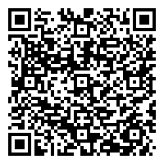
EXTERNAL SERVICES
RECRUITMENT, SELECTION AND PROMOTION PROCEDURE
Process
Citizen’s Charter

Slide 57
3. Recruitment, Selection and Promotion Procedure
This procedure defines the process for recruiting, selecting and promoting the most qualified candidate to meet TPB’s Strategic Objectives on having a highly professional workforce.
Office or Division: | Administrative Department Personnel and Human Resources Development Division
Classification: | Complex
Type of Transaction: | G2G - Government to Government, G2C – Government to Citizen
Who may avail: | Individuals

Slide 58
3. Recruitment, Selection and Promotion Procedure
CHECKLIST OF REQUIREMENTS | WHERE TO SECURE
Approved Request to Fill-Up Vacant Position/s and/or directive from the Head of Agency and/or TPB Board of Directors to fill up vacant position/s | ● Memorandum or Minutes of the Board Meeting
Application Requirements: ● Personal Data Sheet (CSC Form No. 212) and Work Experience Sheet (CSC Form No.212 Attachment) ● Copy of Diploma and Transcript of Records ● Copy of Training Certificates ● Copy of Authenticated CSC Eligibility ● Performance Rating for the last two (2) rating periods (if applicable) ● Certification of Duties and Responsibilities | ● CSC Website ● CSC NCR/Central/Regional Office ● Previous Employer ● Previous Employer

Slide 59
3. Recruitment, Selection and Promotion Procedure
Appointment Requirements: ● Appointment Transmittal and Action Form (CS Form No. 1) ● Appointment Form (CS Form No. 33-A) ● Personal Data Sheet (CSC Form No. 212) and Work Experience Sheet (CSC Form No. 212 Attachment) ● Authenticated Certificate of Eligibility/Rating/License ● Position Description Form (DBM-CSC Form No. 1) ● Oath of Office (CS Form No. 32) ● Certification of Assumption to Duty (CS Form No. 4) | ● CSC Website ● CSC Website ● CSC Website ● CSC NCR/Central/Regional Office ● CSC Website ● CSC Website ● CSC Website

Slide 60
3. Recruitment, Selection and Promotion Procedure
Employment Requirements for New Appointees: ● Updated NBI Clearance ● CSC Medical Certificate with documentary stamp ● Statement of Assets and Liabilities ● Information Form for GSIS ● Information Form for Philhealth ● Information Form for Pag-ibig ● Copy of Form 1902 ● Marriage Contract (if married) ● Birth Certificate of children (if any) | ● Any NBI Branches ● CSC Medical Certificate Form on CSC Website and documentary stamp at Post-Office ● CSC Website ● GSIS Website ● Philhealth Website ● Pag-ibig Website ● Previous Employer ● Philippine Statistics Authority (formerly NSO) ● Philippine Statistics Authority (formerly NSO)

Slide 61
3. Recruitment, Selection and Promotion Procedure
Employment Requirements for Transferees: ● Updated NBI Clearance ● CSC Medical Certificate with documentary stamp ● Statement of Assets and Liabilities ● Information Form for GSIS ● Information Form for Philhealth ● Information Form for Pag-ibig ● Copy of Form 1902 ● Marriage Contract (if married) ● Birth Certificate of children (if any) ● Approved Permission to Transfer ● Accomplished Clearance Form ● Performance Rating for the last two (2) rating period ● Certificate of Last Payment of Salary ● Certification that no Gratuity or Retirement Benefits were claimed/received ● Certification of Accumulated Leave Credits ● Service Record ● Latest Appointment Paper/Latest Notice of Salary Adjustment | ● Any NBI Branches ● CSC Medical Certificate Form on CSC Website and documentary stamp at Post-Office ● CSC Website ● GSIS Website ● Philhealth Website ● Pag-ibig Website ● Previous Employer ● Philippine Statistics Authority (formerly NSO) ● Philippine Statistics Authority (formerly NSO) ● Previous Government Employer ● CSC Website and Previous Government Employer ● Previous Government Employer ● Previous Government Employer ● Previous Government Employer ● Previous Government Employer ● Previous Government Employer ● Previous Government Employer

Slide 62
3. Recruitment, Selection and Promotion Procedure
CLIENT STEPS | AGENCY ACTIONS | FEES TO BE PAID | PROCESSING TIME | PERSON RESPONSIBLE
Submit application requirements | 1.1 Received application requirements within the 10 calendar days of publication of the approved vacant positions to fill up pursuant to RA 7041 and acknowledge, screen completeness and conduct initial qualification assessment after the 10 calendar days of publication | None | ● Received approved Request to fill up vacant positions - 1 working day ● Identification of qualification standards - 1 working day | HRMO and HRMA HRMO

Slide 63
3. Recruitment, Selection and Promotion Procedure
CLIENT STEPS | AGENCY ACTIONS | FEES TO BE PAID | PROCESSING TIME | PERSON RESPONSIBLE
 | ● Send an email template of regrets to those applicants for employment and/or promotion who failed to submit complete application requirements. ● To those who submit complete application requirements and are found qualified, proceed to Step 1.2. |  | ● Source out applicants - 10 calendar days ● Acknowledgment, screening, and initial assessment - 3 working days per position | HRMO and HRMA HRMA

Slide 64
3. Recruitment, Selection and Promotion Procedure
CLIENT STEPS | AGENCY ACTIONS | FEES TO BE PAID | PROCESSING TIME | PERSON RESPONSIBLE
 | ● For candidate not meeting the minimum CSC qualification standards of the position, send an email template of regrets 1.2 Schedule and endorse to the external provider for examination/ assessment and conduct Background Verification. | None | 1 working day (results after 10 working days) | HRMA

Slide 65
3. Recruitment, Selection and Promotion Procedure
CLIENT STEPS | AGENCY ACTIONS | FEES TO BE PAID | PROCESSING TIME | PERSON RESPONSIBLE
2. Confirm and commit attendance and completion of Online Assessment | 1.1 Candidates endorsed and scheduled for Online Assessment shall confirm and commit attendance and completion of Online Assessment. Otherwise, it will mean withdrawing their application. ● The validity of the assessment result is one (1) year from the date of assessment. ● The minimum result of assessment - Moderately Recommended |  |  | HRMA

Slide 66
3. Recruitment, Selection and Promotion Procedure
CLIENT STEPS | AGENCY ACTIONS | FEES TO BE PAID | PROCESSING TIME | PERSON RESPONSIBLE
 | 2.2 Endorse and coordinate with candidates meeting the minimum Moderately Recommended result in the Online Assessment for employment and/or promotion to the HRMPSB for interview and deliberation upon receipt of the result of the examination/ assessment. | None | 5 working day (results after 10 working days) | HRMO and HRMA

Slide 67
3. Recruitment, Selection and Promotion Procedure
CLIENT STEPS | AGENCY ACTIONS | FEES TO BE PAID | PROCESSING TIME | PERSON RESPONSIBLE
3. Confirm attendance to the scheduled HRMPSB interview and deliberation | 3.1 Conduct HRMPSB interview and deliberation and submission of Recommendation Forms and Candidate Rating Sheets. 3.2 Prepare minutes of the deliberation and HRMPSB Resolution upon receipt of the complete Recommendation Forms and Candidate Rating Sheets and endorse to the Head of Agency once approved by the HRMPSB Members. | None None | 5 working days 3 working days | HRMPSB Members HRMO

Slide 68
3. Recruitment, Selection and Promotion Procedure
CLIENT STEPS | AGENCY ACTIONS | FEES TO BE PAID | PROCESSING TIME | PERSON RESPONSIBLE
 | ● The Head of Agency approves or disapproves appointment/ promotion. ● For the Board Secretary V, Internal Auditor V, and Deputy Chief Operating Officers positions, endorse to the Office of the Corporate Board Secretary for TPB Board of Directors interview and deliberation. | None None | 3 working days 3 working days | Head of agency HRMO

Slide 69
3. Recruitment, Selection and Promotion Procedure
CLIENT STEPS | AGENCY ACTIONS | FEES TO BE PAID | PROCESSING TIME | PERSON RESPONSIBLE
 | ● For qualified and not qualified candidates in the TPB Board of Directors interview and deliberation, proceed to step 3.3. 3.3 For approved appointment of coterminous, newly hired and/or promotion, prepare CSC Appointment Paper Form No. 33-A for endorsement to the Head of Agency. ● For disapproved appointment/ promotion, send a Letter of Regret. | None | 3 working days | HRMO and HRMA

Slide 70
3. Recruitment, Selection and Promotion Procedure
CLIENT STEPS | AGENCY ACTIONS | FEES TO BE PAID | PROCESSING TIME | PERSON RESPONSIBLE
 | 3.4 Issue the appointment documents to the coterminous, newly hired and/or promoted employee. 3.5 Post Notice or Memorandum announcing the Appointment/ Promotion or Protest at 3 conspicuous places in TPB for fifteen (15) calendar days. | None None | 3 working days 15 working days | HRMO and HRMA HRMA

Slide 71
3. Recruitment, Selection and Promotion Procedure
CLIENT STEPS | AGENCY ACTIONS | FEES TO BE PAID | PROCESSING TIME | PERSON RESPONSIBLE
4. Submit employment requirements. | 4.1 If no Protest, receive requirements from the coterminous, newly hired, and/or promoted employee and release the copy of signed CSC Appointment Paper Form No. 33-A for acknowledgment. ● If with Protest, resolve protest pursuant to CSC rules and regulations. Schedule TPB Onboarding Orientation prior to assumption to duty. | None | 1 working day | HRMA

Slide 72
3. Recruitment, Selection and Promotion Procedure
CLIENT STEPS | AGENCY ACTIONS | FEES TO BE PAID | PROCESSING TIME | PERSON RESPONSIBLE
5. Confirm attendance to the scheduled TPB Onboarding Orientation and virtual Oath Taking | 5.1 Conduct TPB Onboarding Orientation 5.2 Conduct virtual Oath Taking to the coterminous, newly hired and/or promoted employee during the Monthly Town Hall Meetings. | None None | 1 working day 1 working day | HRMO and HRMA HRMO and Head of Agency
6. Assumption to Duty | 6.1 Deploy coterminous, newly hired, and/or promoted employees and issue Certificate of Assumption to Duty and have it signed by the concerned Department Head. | None | 1 working day | HRMO and HRMA

Slide 73
3. Recruitment, Selection and Promotion Procedure
CLIENT STEPS | AGENCY ACTIONS | FEES TO BE PAID | PROCESSING TIME | PERSON RESPONSIBLE
 | 6.2 Submit signed Appointment Paper with prescribed supporting documents to CSC for evaluation and approval within thirty (30) days from the date of appointment. | None | 1 working day | HRMO and HRMA
TOTAL TIME | 43 working days & 25 calendar days - CSC requirement – 10 days ( publication ) & 15 days ( in case of protest )
*From date screened and acknowledged receipt of application requirements to the Head of Agency’s approval/disapproval of appointment/ promotion | 33 working days
**For Board Secretary V, Internal Auditor V, and Deputy Chief Operating Officers position | 36 working days
***Subject to and based on position line-up/ volume of applicants to be processed

Slide 74
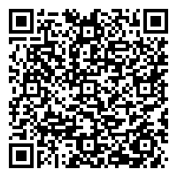
EXTERNAL SERVICES
REVIEW OF CONTRACTS/ AGREEMENTS WITH DOT REGIONAL AND FOREIGN OFFICES
Process
Citizen’s Charter

Slide 75
4. Review of Contracts/ Agreements with DOT Regional and Foreign Offices
To review Contracts/Agreements within a period of ten (10) working days upon receipt of request supported by complete documents from the Requesting Department up to the release of reviewed contract or agreement for execution, of TPB projects requiring the execution of Contracts and Agreements with the Department of Tourism Regional and Foreign Offices.
Office or Division: | Legal Department
Classification: | Highly-Technical Support/Complex
Type of Transaction: | G2G - Government to Government
Who may avail: | TPB Office of the Chief Operating Officer, Office of the Deputy COO for Marketing and Promotions, Office of the Deputy COO for Corporate Affairs, International Promotions Department, Domestic Promotions Department, MICE Department, Marketing Communications Department, Administrative Department, Finance Department, Corporate Planning and Business Development Department, Management Information Department, DOT Regional and Foreign Offices

Slide 76
4. Review of Contracts/ Agreements with DOT Regional and Foreign Offices
CHECKLIST OF REQUIREMENTS | WHERE TO SECURE
● Board Approved Corporate Operating Budget ● Work and Financial Plan ● Approved Project Proposal Form ● Approved Budget Breakdown ● Complete Staff Work by DOT Regional/Foreign Office ● Certificate of Funds Availability ● Approved Realignment of Funds, if applicable ● Market Study, if applicable ● Value Contribution/ Investment of Contracting Party, if applicable ● Authority of the DOT Tourism Attaché/Regional Director to sign and execute the agreement and to implement the project | To be submitted by the Requesting Department.

Slide 77
4. Review of Contracts/ Agreements with DOT Regional and Foreign Offices
CLIENT STEPS | AGENCY ACTIONS | FEES TO BE PAID | PROCESSING TIME | PERSON RESPONSIBLE
1. Submit request form for the Review of Contracts/Agreements with DOT Regional and Foreign Offices and supporting documents. | 1.1 Stamp receipt, check supporting documents and record entries. 1.2 Assign the request to the Lawyer/Legal Researcher/Legal | None | Within 3 hours from receipt of documents Within 1 working day from receipt of documents | Legal Assistant Department Head or OIC

Slide 78
4. Review of Contracts/ Agreements with DOT Regional and Foreign Offices
CLIENT STEPS | AGENCY ACTIONS | FEES TO BE PAID | PROCESSING TIME | PERSON RESPONSIBLE
 | 1.3 Review the draft Contract/ Agreement and prepare the initial draft, if warranted. 1.4 Review the initial draft of the Contract/ Agreement. 1.5 Release the initial draft of the Contract/ Agreement or the recommendation/ opinion to the Requesting Department. |  | Within 3 days from receipt of documents Within 2 days from receipt of documents Within 1 working day from receipt of documents | Assigned Lawyer/Legal Researcher/Legal Staff Department Head or OIC Legal Assistant

Slide 79
4. Review of Contracts/ Agreements with DOT Regional and Foreign Offices
CLIENT STEPS | AGENCY ACTIONS | FEES TO BE PAID | PROCESSING TIME | PERSON RESPONSIBLE
2. Receive the draft Contract/Agreement for second/final review. | 2.6 Stamp receipt, check supporting documents and record entries. 2.7 Conduct Second or Final Review of the draft Contract/ Agreement or Evaluate and review the Memorandum or Letter for Reconsideration from the Requesting Department. 2.8 Finalization and Release of the proposed Contract/Agreement for Execution. | None | Within 3 hours from receipt of documents Within 1 working day from receipt of documents Within 1 working day from receipt of confirmation | Legal Assistant Department Head or OIC/ Assigned Lawyer/Legal Researcher/Legal Staff Department Head or OIC/ Assigned Lawyer/Legal Researcher/Legal Assistant

Slide 80
4. Review of Contracts/ Agreements with DOT Regional and Foreign Offices
CLIENT STEPS | AGENCY ACTIONS | FEES TO BE PAID | PROCESSING TIME | PERSON RESPONSIBLE
3. Submission of Notarized Copies of Contract/Agreement by the Requesting Department | 3.1 Stamp receipt the Notarized Copies of Contract/ Agreement prior to the implementation of the Project. 3.2 File Records. | None | Within 2 hours upon receipt | Legal Assistant
TOTAL PROCESSING TIME |  |  | 10 working days

Slide 81
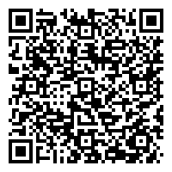
EXTERNAL SERVICES
TPB MEMBERSHIP APPLICATION
Process
Citizen’s Charter

Slide 82
5. TPB Membership Application
To assess and process the application for membership of stakeholders
Office or Division: | Domestic Promotions Department/ Industry Relations and Services Division
Classification: | Simple
Type of Transaction: | G2C, G2B
Who may avail: | Accommodation Establishments, Travel and Tour Services, MICE Facilities/ Organizers, Health and Wellness Facilities, Tourism Related Enterprises

Slide 83
5. TPB Membership Application
CHECKLIST OF REQUIREMENTS | WHERE TO SECURE
Valid Department of Tourism (DOT) Accreditation Certificate or Provisional Accreditation Certificate if Renewal is on process | To be submitted by the applicant
Certificate of Employment
2x2 photo

Slide 84
5. TPB Membership Application
CLIENT STEPS | AGENCY ACTIONS | FEES TO BE PAID | PROCESSING TIME | PERSON RESPONSIBLE
1. Fill-out the TPB Membership Online Application Form and submit requirements. | 1.1 Receive the TPB Membership Online Application Form and its attachments 1.2 Assessment of TPB Membership Application Form and verification of client’s DOT Accreditation. 1.3 Preparation of Statement of Account (SOA). 1.4 Issuance of SOA. | None | 30 minutes 1 day 2 days 30 minutes | Marketing Officer Marketing Officer Finance Department Marketing Officer

Slide 85
5. TPB Membership Application
CLIENT STEPS | AGENCY ACTIONS | FEES TO BE PAID | PROCESSING TIME | PERSON RESPONSIBLE
2. Payment of Membership Fee Note: Payment can be done through bank or TPB Cashier |  | Php 10,000.00* Waiver for 2020 to 2021 per Circular No. 2020-16 dated 15 May 2020 | 10 minutes
3. Submission of proof of payment Note: deposit slip, if payment is through bank; official receipt, if through TPB Cashier | 3.1 Verification of payment (applicable to payments made through bank transfers/ bank deposit) 3.2 Issuance of notice of approval. |  | 3 days 1 day | Finance Department Marketing Officer
 |  |  | 7 working days, 1hour and 10 minutes

Slide 86
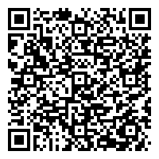
EXTERNAL SERVICES
EXTERNAL SERVICES
EVALUATION OF MARKETING PROPOSALS/ REQUESTED ASSISTANCE
Evaluation of Marketing Proposals/ Requested Assistance
Process
Citizen’s Charter

Slide 87
6. Evaluation of Marketing Proposals/ Requested Assistance
To evaluate marketing proposals and activities or assist international events that would help promote the Philippines as a premier travel/ MICE destination
Office or Division: | Marketing and Promotions
Classification: | Technical
Type of Transaction: | G2C, G2B, and G2G
Who may avail: | All Tourism and MICE Stakeholders, DOT Overseas Offices/ Regional Offices, Media Agencies, etc.

Slide 88
6. Evaluation of Marketing Proposals/ Requested Assistance
CHECKLIST OF REQUIREMENTS | WHERE TO SECURE
Letter of Request/ Proposal | To be submitted by the requesting party
If requesting party is a Travel Trade or Tourism Association: ● Letter of Request ● Project Proposal ● Detailed Budget Breakdown | To be submitted by the requesting party
If requesting party is Local Government Unit: ● Letter of Request ● Project Proposal using TPB Template ● Endorsement from the concerned DOT Regional Office ● Endorsement from Provincial Government Office (if requesting party is a city or municipality, if applicable) | To be submitted by the requesting party From TPB ℅ Domestic Promotions Department - Industry Relations and Services Division

Slide 89
6. Evaluation of Marketing Proposals/ Requested Assistance
CHECKLIST OF REQUIREMENTS | WHERE TO SECURE
If requesting party is from DOT Regional Offices or Attached Agencies: ● Certification of Non-inclusion in the Work Program for the Year ● Itemized list of regional projects ● Fund utilization timelines/cash flow ● Project proposal ● Budget breakdown ● Funding evaluation measures ● Project evaluation criteria | To be submitted by the requesting party From TPB ℅ Domestic Promotions Department - Industry Relations and Services Division
If requesting party would like to avail of TPB support for their MICE Event/s in the Philippines, requesting party should accomplish the MICE Event Support and Assistance Form | https://www.tpb.gov.ph/enhanced-mice-plus-program/

Slide 90
6. Evaluation of Marketing Proposals/ Requested Assistance
CLIENT STEPS | AGENCY ACTIONS | FEES TO BE PAID | PROCESSING TIME | PERSON RESPONSIBLE
1. Submit the Letter of Request to the ODCOO for Marketing & Promotions | 1.1 Receive the Letter of Request. 1.2 Acknowledgment of Receipt of Request and Endorsement to the Relevant Department 1.3 Assignment of Project Officer Coordinator |  | N/A 1 working day 1 working day | ODCOO for Marketing and Promotions ODCOO for Marketing and Promotions Department Manager & Division Chief

Slide 91
6. Evaluation of Marketing Proposals/ Requested Assistance
CLIENT STEPS | AGENCY ACTIONS | FEES TO BE PAID | PROCESSING TIME | PERSON RESPONSIBLE
 | 1.4 Evaluation/ Verification of Completeness of Documents and Information/ Drafting of Recommendation |  | 4-7 working days (for requests not requiring market study) Note: Processing of the proposal will start upon receipt of complete information and supporting documents 7-22 working days (for proposals requiring a market study) | Project Officer

Slide 92
6. Evaluation of Marketing Proposals/ Requested Assistance
CLIENT STEPS | AGENCY ACTIONS | FEES TO BE PAID | PROCESSING TIME | PERSON RESPONSIBLE
 | 1.5 Review and Endorsement to concerned offices 1.6 Budget Allocation (if applicable) 1.7 Final Review/ Approval |  | 3 working days 2 – 3 working days 2 – 3 working days | Division Chief Department Manager/ Deputy Chief Operating Officer- Marketing and Promotions Sector Finance Department OCOO/ COO

Slide 93
6. Evaluation of Marketing Proposals/ Requested Assistance
CLIENT STEPS | AGENCY ACTIONS | FEES TO BE PAID | PROCESSING TIME | PERSON RESPONSIBLE
2. Receive official communication (Confirmation/ Regrets). | 2.1 Communicate approval/ disapproval of request. | None | 1 working days | Project Officer
TOTAL NUMBER OF DAYS TO PROCESS A PROPOSAL |  |  | 14 – 17 working days (for requests not requiring market study) 17 – 34 working days (for requests requiring market study)

Slide 94
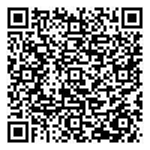
EXTERNAL SERVICES
PROCESSING OF PHILIPPINE SELLER COMPANIES’ PARTICIPATION IN ROADSHOWS, SALES / BUSINESS MISSIONS, TRAVEL TRADE, MICE FAIRS / SHOWS
Process
Citizen’s Charter

Slide 95
7. Processing of Philippine Seller Companies’ Participation in Roadshows, Sales / Business Missions, Travel Trade, MICE Fairs / Shows
To facilitate participation of Philippine tourism/ MICE stakeholders in international Travel Trade, MICE and Consumer Fairs/ Shows (TTMCF) and Business Missions.
Office or Division: | Marketing and Promotions
Classification: | Complex
Type of Transaction: | G2B and G2G
Who may avail: | All Tourism and MICE Stakeholders

Slide 96
7. Processing of Philippine Seller Companies’ Participation in Roadshows, Sales / Business Missions, Travel Trade, MICE Fairs / Shows
CHECKLIST OF REQUIREMENTS |  | WHERE TO SECURE
Participation Agreement Form DOT accreditation and/or PCSSD (for dive shows) |  | Invitation to Participate to be sent out by the concerned Department
CLIENT STEPS | AGENCY ACTIONS | FEES TO BE PAID | PROCESSING TIME | PERSON RESPONSIBLE
1. Email concerned Project Officer of intent to participate | 1.1 Email back the Participation Agreement Form to interested company *subject to availability of slots (reservation is on a first-come, first-served basis) | N/A | 0.5 working day | Project Officer

Slide 97
7. Processing of Philippine Seller Companies’ Participation in Roadshows, Sales / Business Missions, Travel Trade, MICE Fairs / Shows
CLIENT STEPS | AGENCY ACTIONS | FEES TO BE PAID | PROCESSING TIME | PERSON RESPONSIBLE
2. Submit duly accomplished Participation Agreement Form (together with DOT accreditation and/or PCSSD accreditation for dive shows)* *subject to availability of slots (reservation is on a first-come, first-served basis) | 2.1 Receive accomplished Participation Agreement Form 2.2 Process request of Statement of Account (SOA), upon request of client 2.3 Processing of Statement of Account (SOA), upon request of client 2.4 Issuance of SOA to client | N/A | N/A 0.5 working day 1-2 working days 1 working day | Project Officer Project Officer Accounting Division Project Officer

Slide 98
7. Processing of Philippine Seller Companies’ Participation in Roadshows, Sales / Business Missions, Travel Trade, MICE Fairs / Shows
CLIENT STEPS | AGENCY ACTIONS | FEES TO BE PAID | PROCESSING TIME | PERSON RESPONSIBLE
3. Receive SOA | 3.1 Send SOA to client | * Cost depends on the TTMCF/ Business Mission to be participated in | N/A | Project Officer
4. Pay Participation Fee (if applicable) | 4.1 Receive Payment of Participation Fee | *Refer to the TPB invitation to participate (Cost depends on the TTMCF/ Business Mission to be participated in) | N/A | TPB Cashier/ TPB Bank (for Bank Deposit)

Slide 99
7. Processing of Philippine Seller Companies’ Participation in Roadshows, Sales / Business Missions, Travel Trade, MICE Fairs / Shows
CLIENT STEPS | AGENCY ACTIONS | FEES TO BE PAID | PROCESSING TIME | PERSON RESPONSIBLE
5. Submit Proof of Payment to Project Officer (if applicable) | 5.1 Receive Proof of Payment 5.2 Forward to Accounting Department for Verification 5.3 Verification of Payment |  | N/A 1 working day 2-3 working day | Project Officer Project Officer Accounting Division
6. Receive Confirmation of Participation | 6.1 Send communication confirming the client’s participation |  | 1 working day | Project Officer
TOTAL NUMBER OF DAYS TO PROCESS |  |  | 7-9 working days

Slide 100
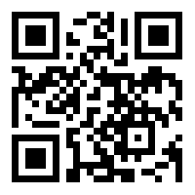
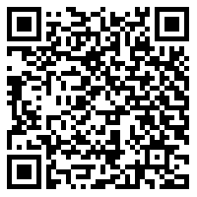
CONTACT US
TOURISM PROMOTIONS BOARD
4F, Legaspi Towers 300, Roxas Blvd., corner P. Ocampo St., Malate Manila, 1004
Trunkline: (02) 8 5259318-27 / (02) 8 5259607-09 / (02) 8 5259622-23
Website: www.tpb.gov.ph Email: info@tpb.gov.ph
TPB CONTACT NUMBERS WEBSITE

Slide 101
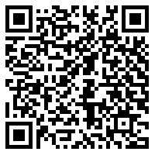
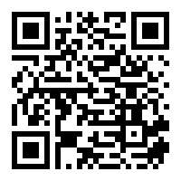
WE VALUE YOUR FEEDBACK
PLEASE SCAN FOR THE FOLLOWING:
PROCEDURE FEEDBACK FORM

Slide 102

THANK YOU AND MABUHAY!

