Slide 1



Incentive Travel Outlook
Experiential | Authentic| Wellness
1
Presenter
Ooi Peng Ee
  Publisher, Tourism Group – Maps & Guides
  Head – TTG Global Commerce

Slide 2
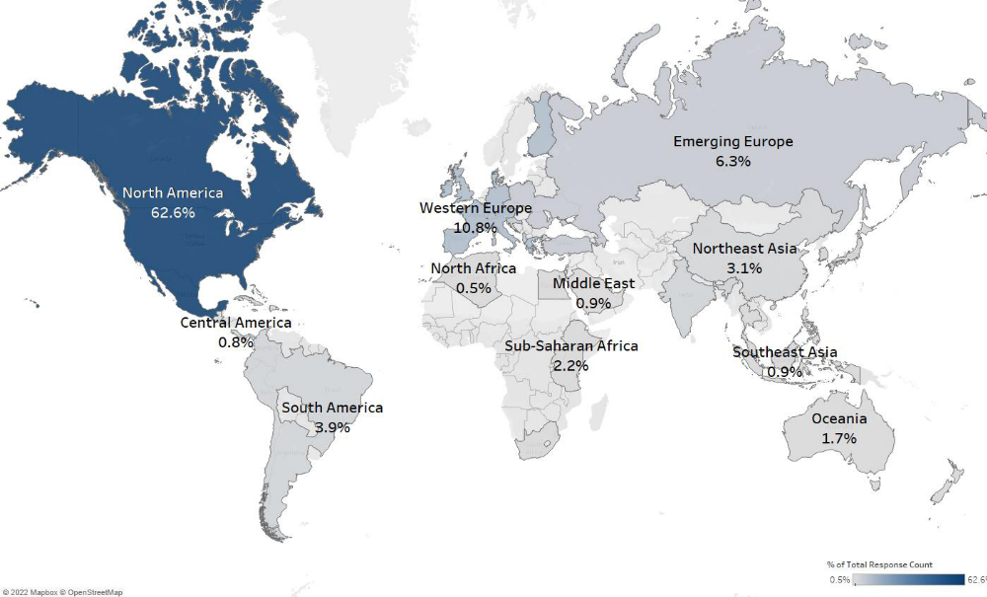
Balance respondents – global perspective
2
n 1,021
62.6% North America,
37.4% rest of the world.
Source: Incentive Travel Index October 2022

Slide 3
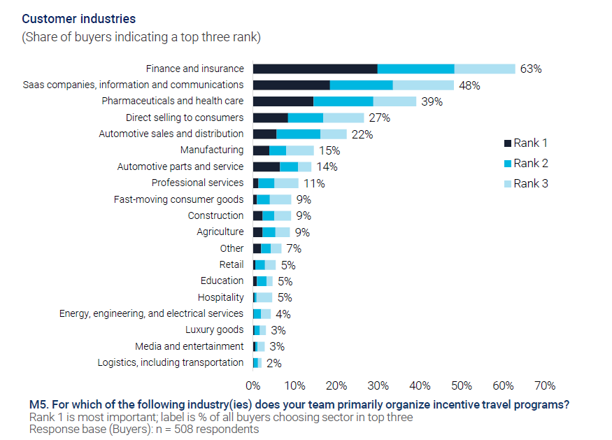
Finance, Insurance and tech tops the industry serve, followed by pharma, healthcare and direct selling
3
n 508
Will the recent tech layoffs knock tech off the number 2 list?
Source: Incentive Travel Index October 2022

Slide 4
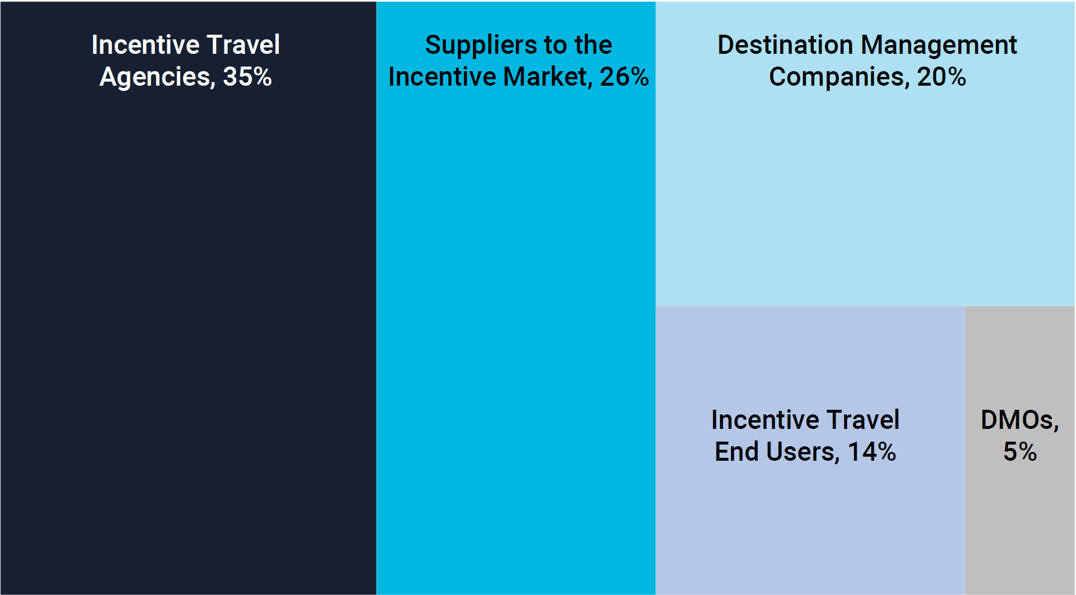
360-degree view of buyers and sellers
4
N 1,417
49% Buyers, 51% Sellers.
Source: Incentive Travel Index October 2022

Slide 5
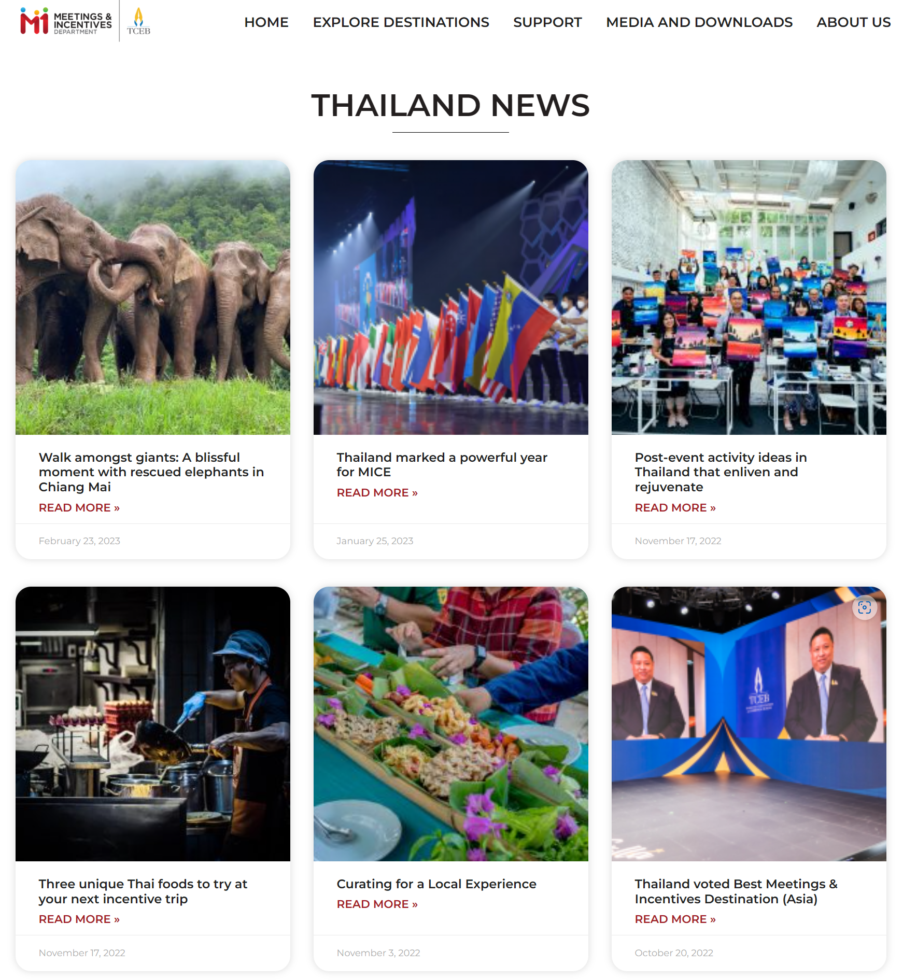
TCEB M&I
5
Key themes are featured
Experiential – Curating & Discovering
Wellness – Enliven & Rejuvenate
Authenticity – Thai Food
Including – CSR, save the elephants
Source: thailandmeetingsincentives

Slide 6
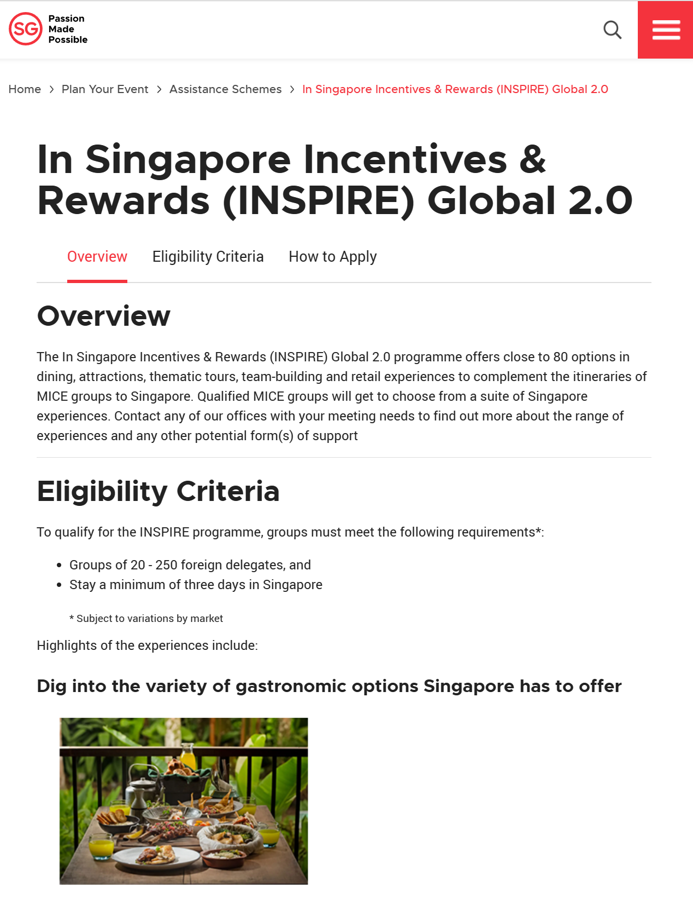
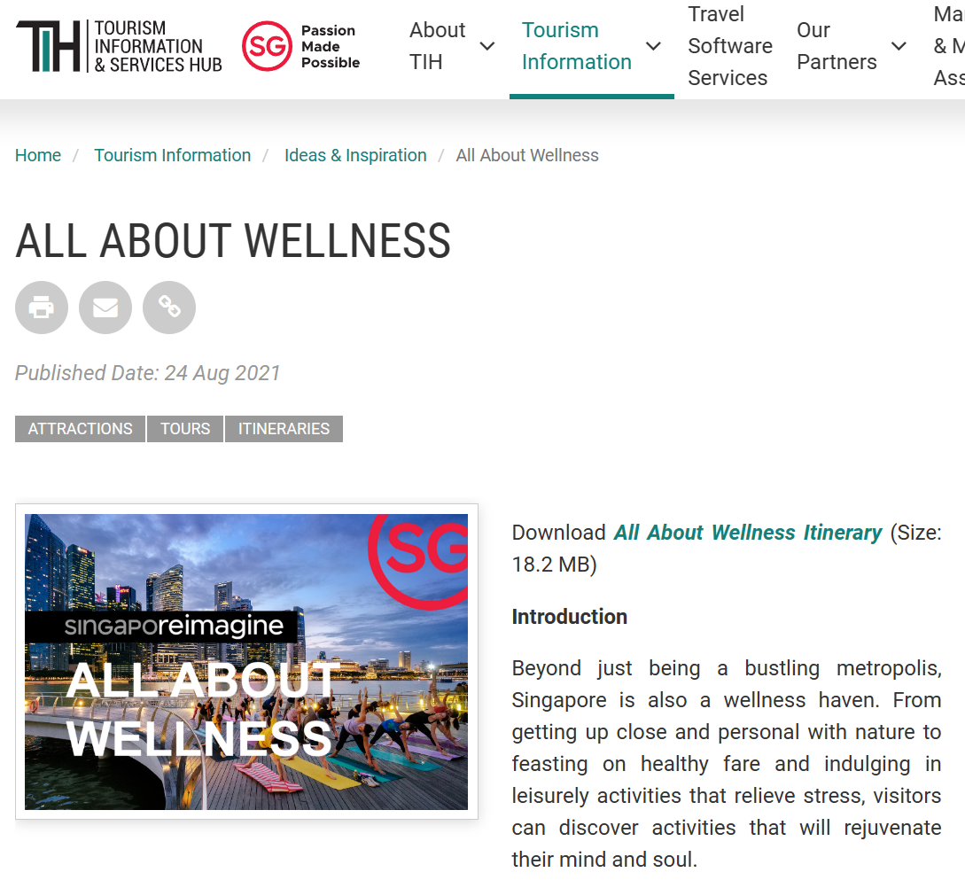
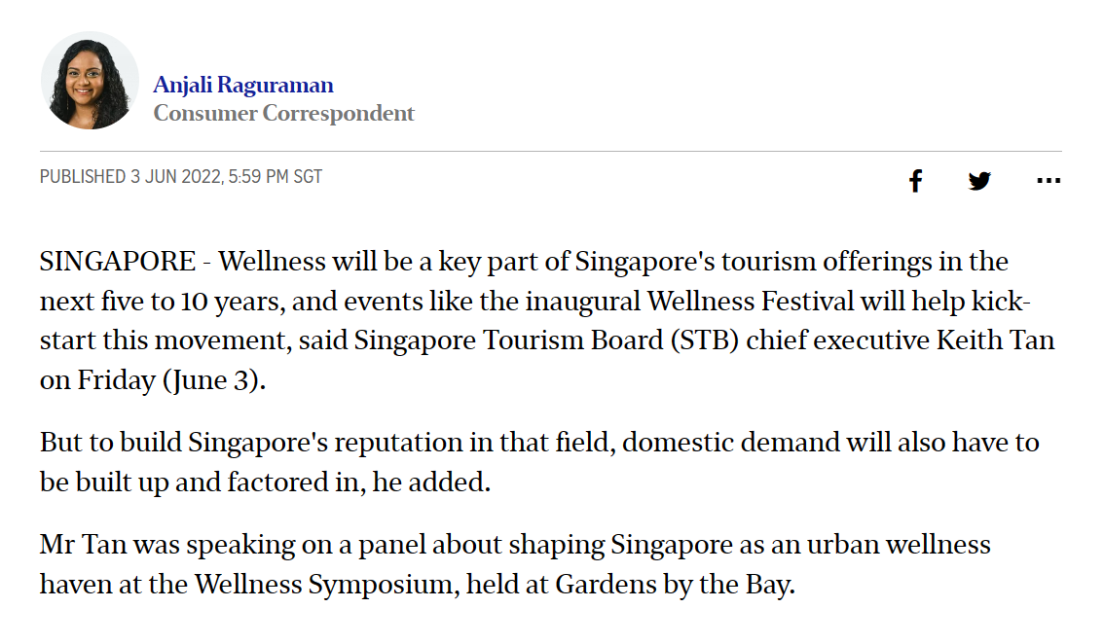
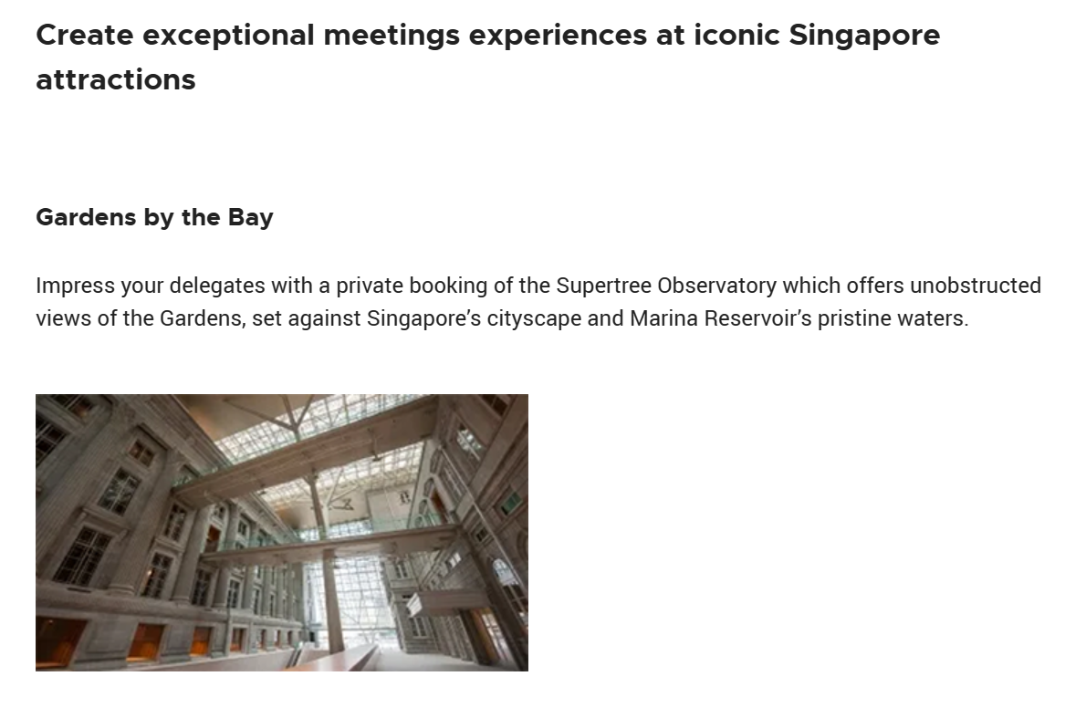
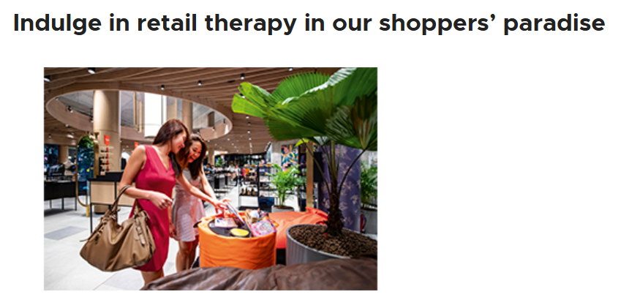
STB INSPIRE
6
Key themes are featured
Experiential – Curating experiences at iconic Singapore attractions
Wellness – Retail Therapy?
Authenticity – Food
Source: stb.gov.sg

Slide 7


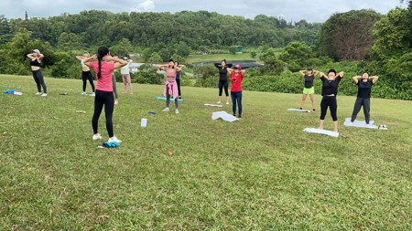
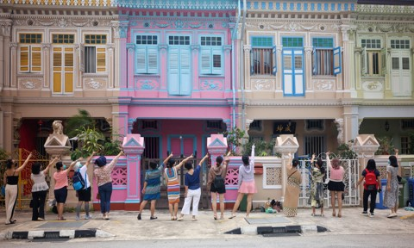

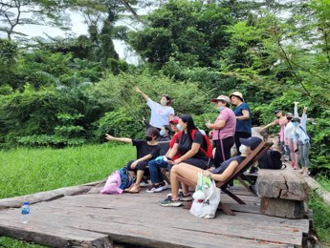
TTG’s Global Commerce
7
Key takeaways
Experiential, wellness, and authentic activities are highly rated and in demand.
Source: TTG Global Commerce Partners Programs 2022

Slide 8
Strategic importance –
Basics remains unchanged
8
Incentive Travel is a profit driver - it has the attention of the C-level.
Helps retain and engage talent – 91% agrees that with a disperse workforce (hot-desking, WFH, MLM), incentive travel will play an important part in role building, engagement and building company culture.
Culture and engagement benefits are front and center – two-thirds of buyers report they are shifting future programs towards a greater focus on soft power benefits, such as company culture and engagement.

Slide 9
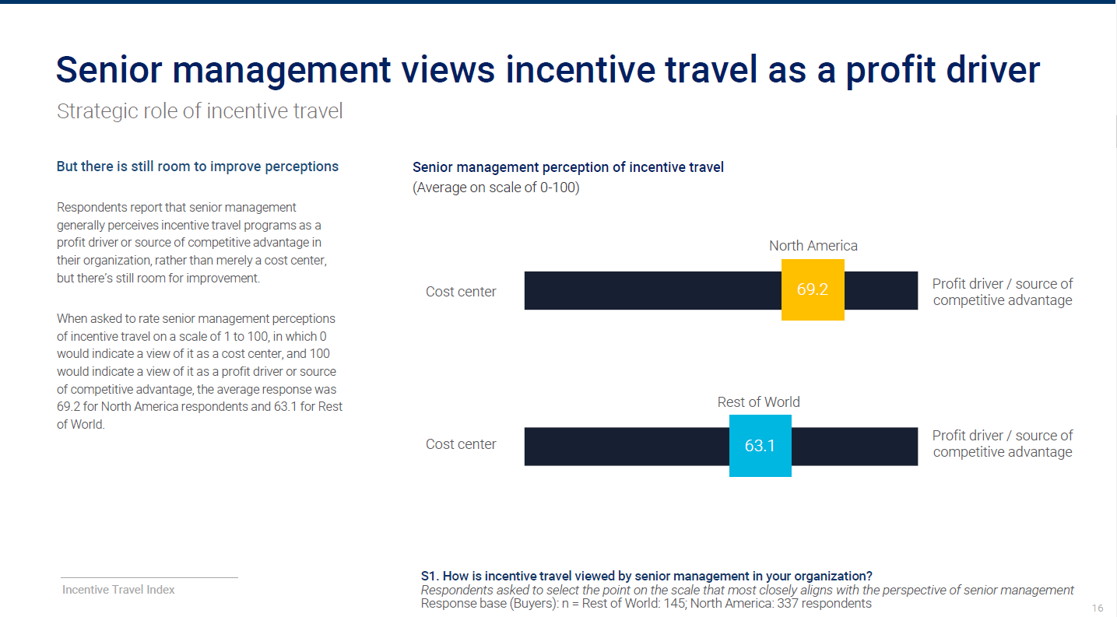
9
Source: Incentive Travel Index October 2022

Slide 10
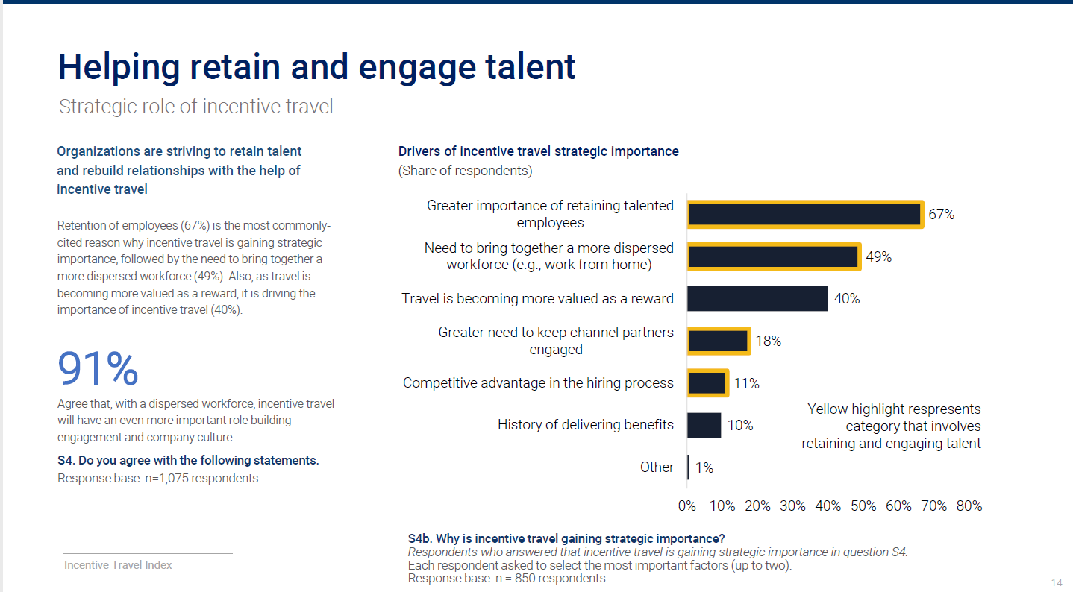
10
Source: Incentive Travel Index October 2022

Slide 11
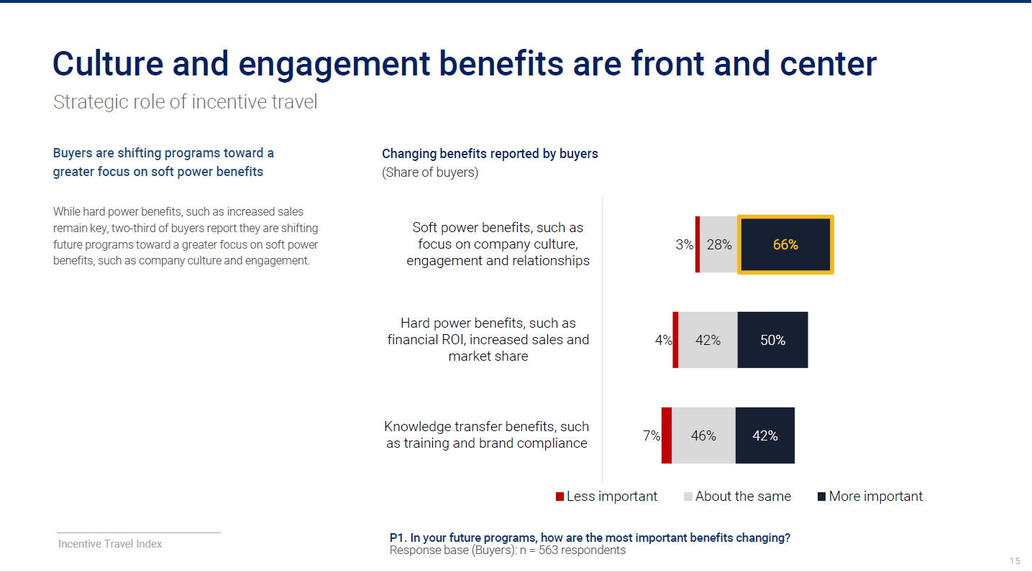
11
Source: Incentive Travel Index October 2022

Slide 12
Recovery
12
67% of North American buyers have resumed incentive programs in international locations; only 50% from ROW reported resuming international programs.
61% expected recovery to above, or significantly above 2019 levels by 2024.
64% expect spending per pax will recover above, or significantly above 2019 levels by 2024.
Over 50% of North American buyers expect incentive travel activity to recover by 2023 only 37% from ROW expect a recovery to 2019 activity by 2023.
80% of respondents cite inflation as a challenge.

Slide 13
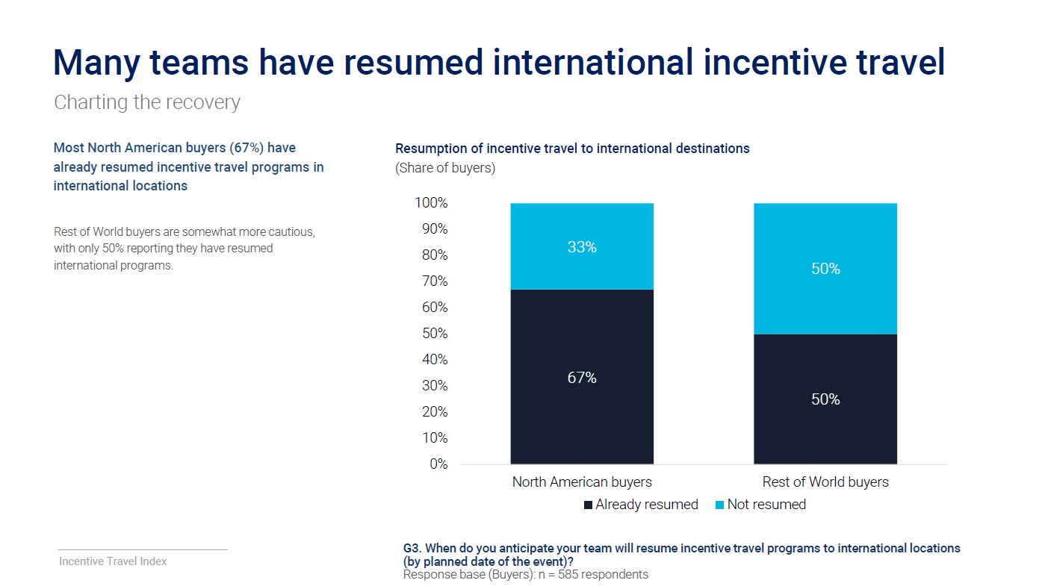
13
Source: Incentive Travel Index October 2022

Slide 14
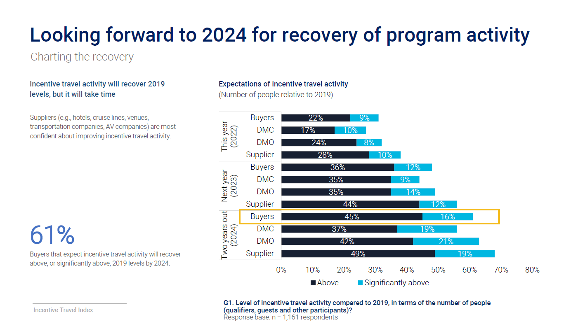
14
Source: Incentive Travel Index October 2022

Slide 15
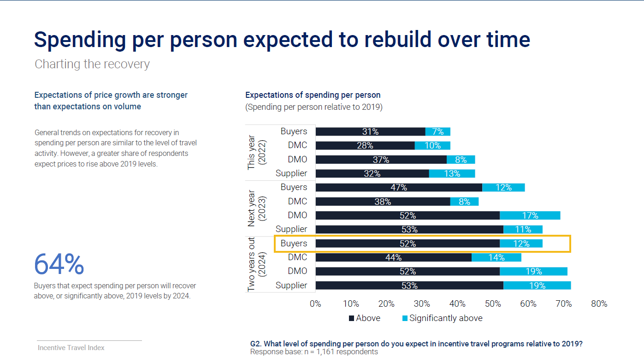
15
Source: Incentive Travel Index October 2022

Slide 16
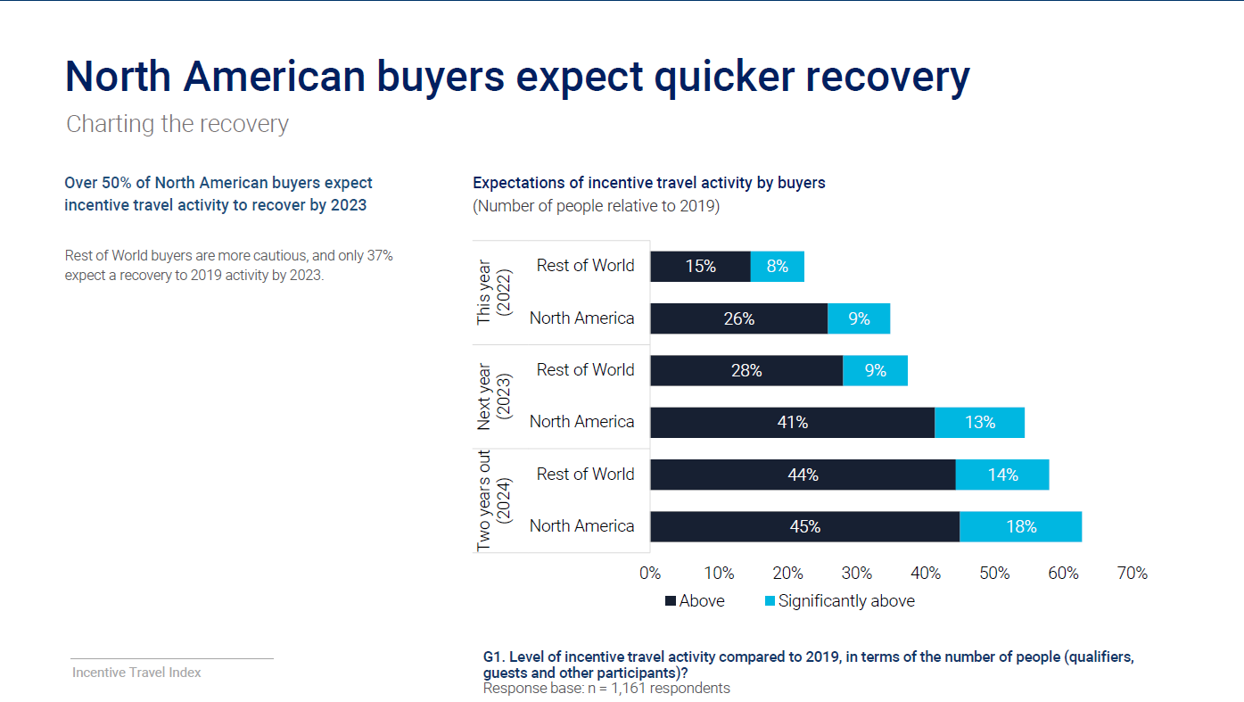
16
Source: Incentive Travel Index October 2022

Slide 17
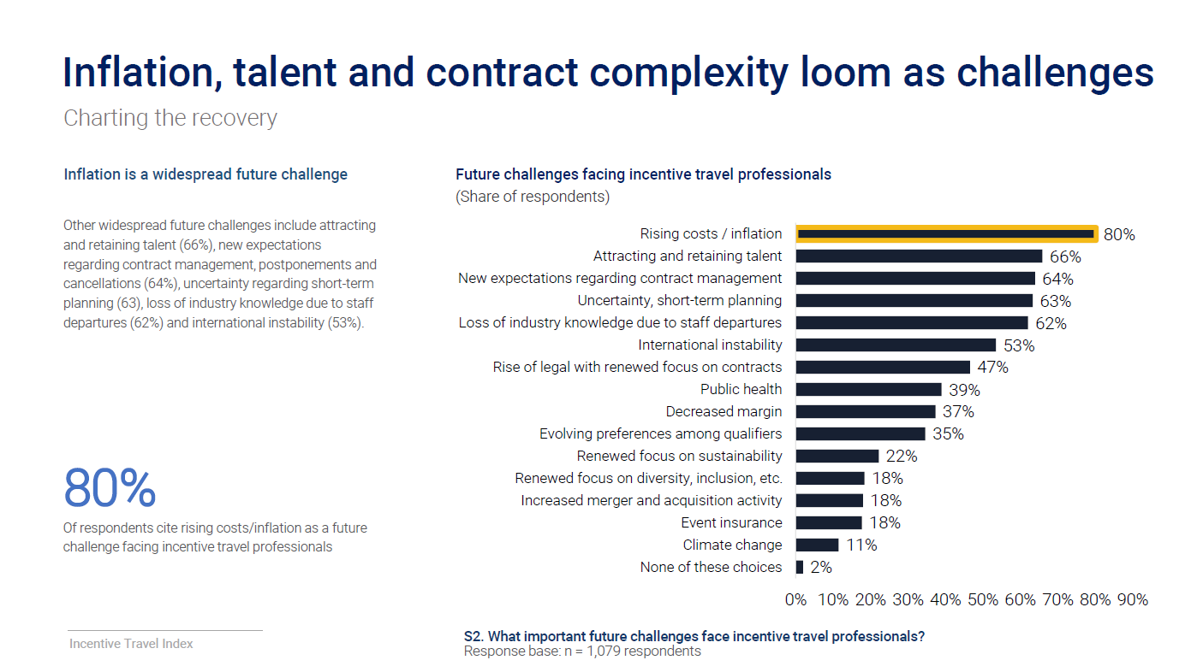
17
Source: Incentive Travel Index October 2022

Slide 18
Program Design and Destination Selection
18
North American buyers are looking closer to home.
Western Europe will see increased demand from buyers outside North America.
Many buyers are open to considering new destinations.
Buyers are actively seeking destinations not used before.
72% of respondents cite activities that promote relationship-building as important to a successful program.
Looking to motivational events to build new relationships.
Health and safety key considerations for program development.
Perceived value drives destination selection.
Summary thoughts – How much of your business is incentive? What are the decision drivers? …

Slide 19
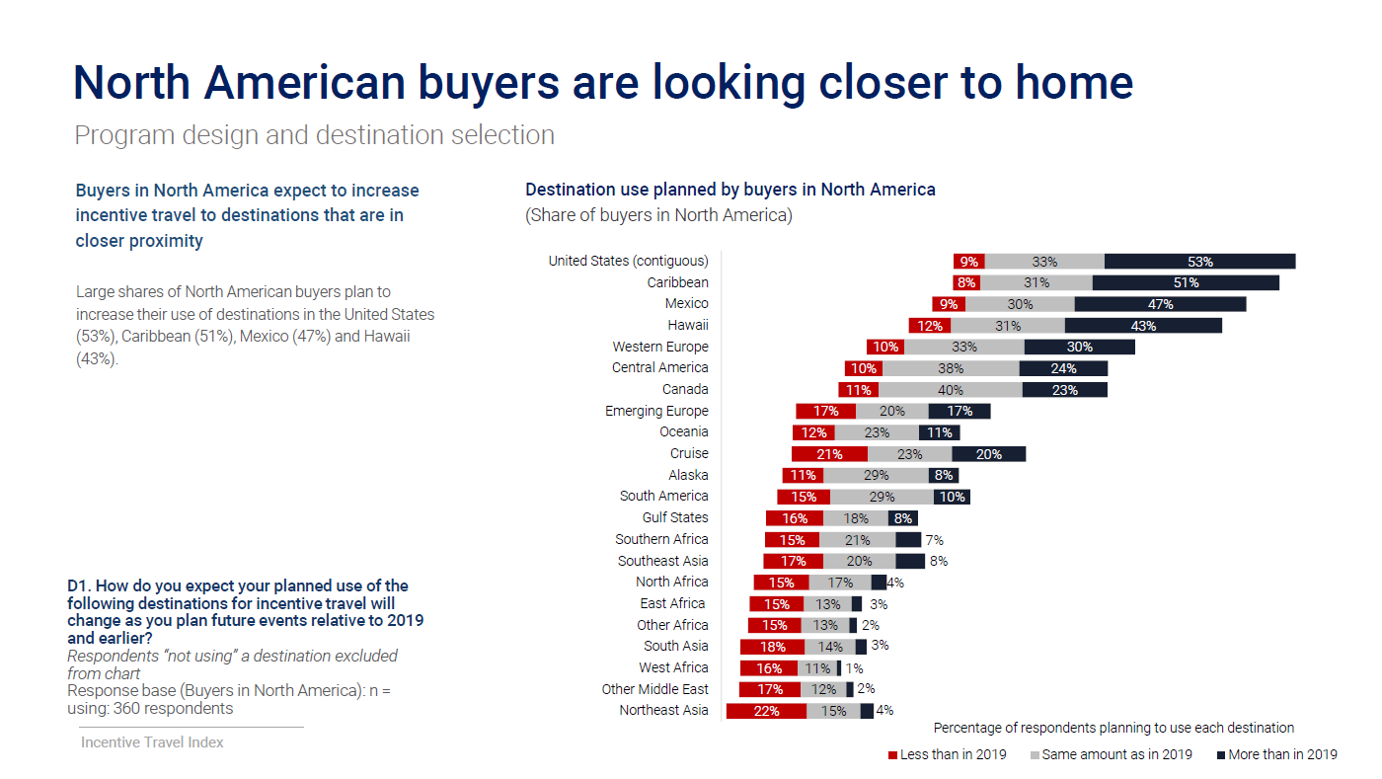
19
Source: Incentive Travel Index October 2022

Slide 20
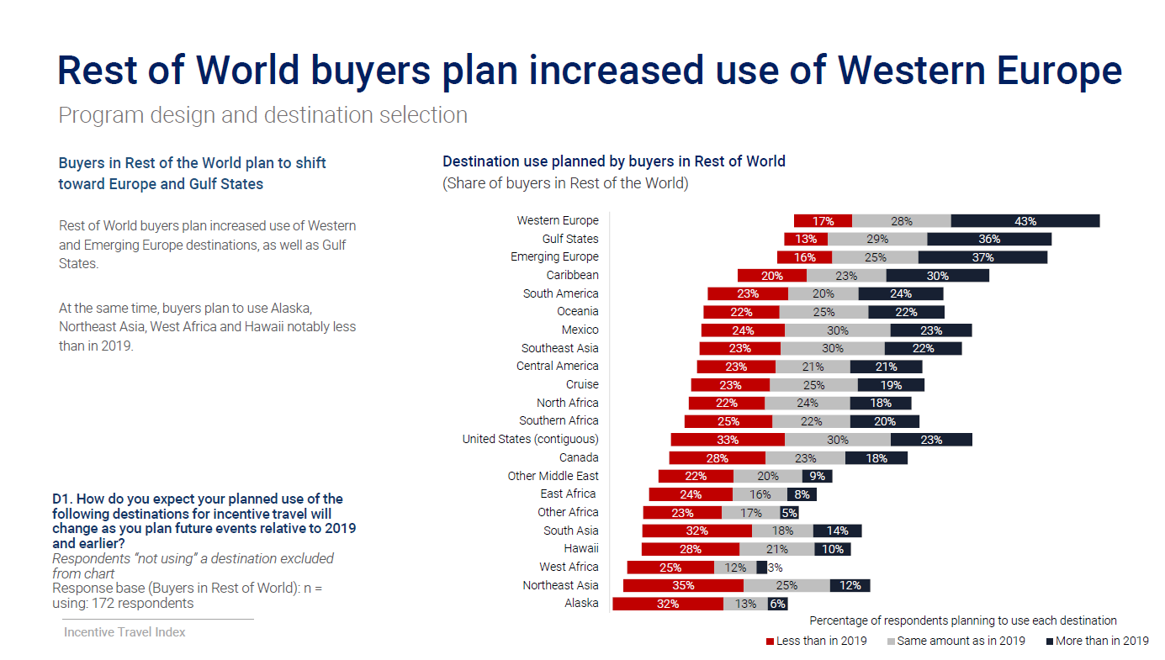
20
Source: Incentive Travel Index October 2022

Slide 21
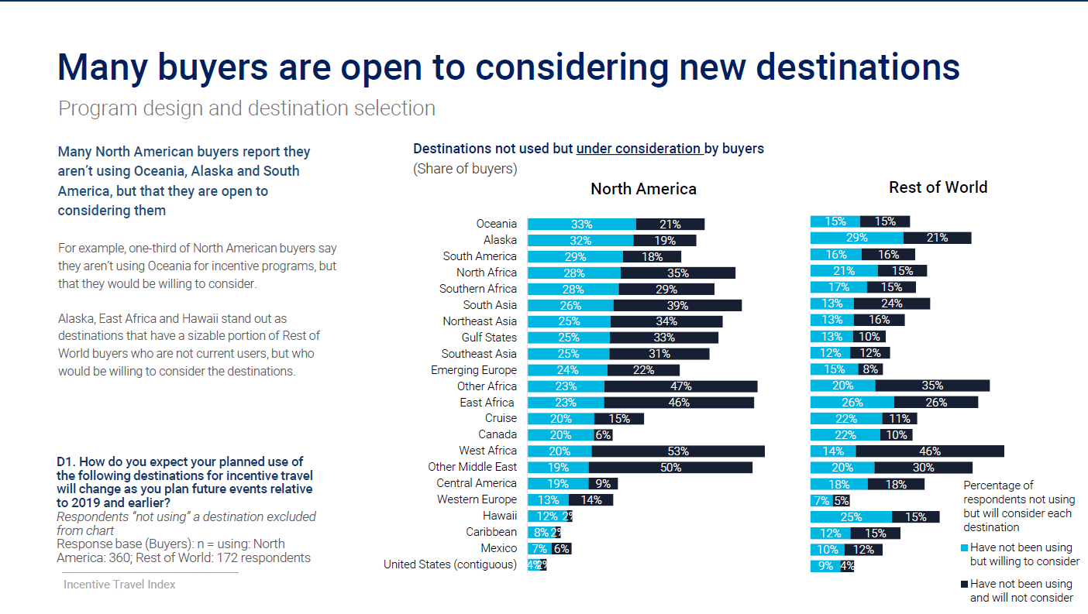
21
Source: Incentive Travel Index October 2022

Slide 22
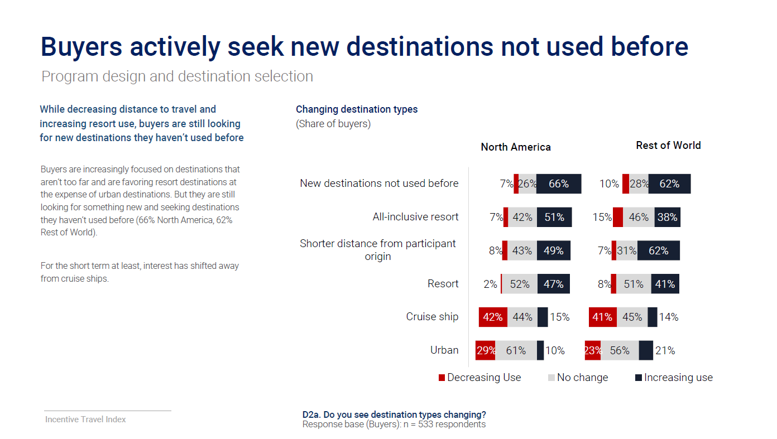
22
Source: Incentive Travel Index October 2022

Slide 23
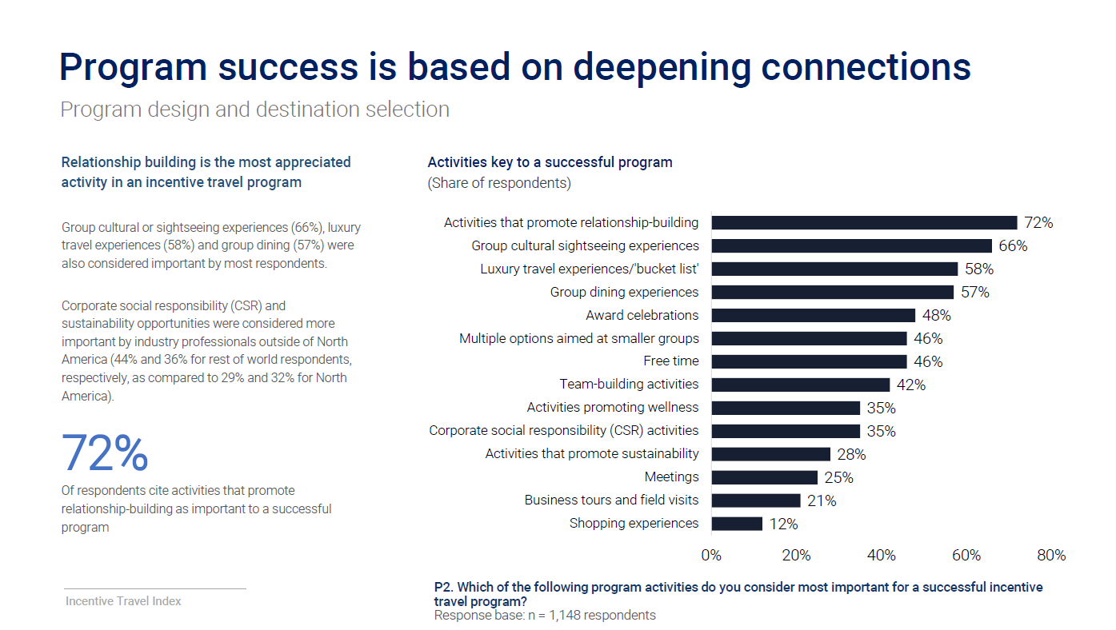
23
Source: Incentive Travel Index October 2022

Slide 24
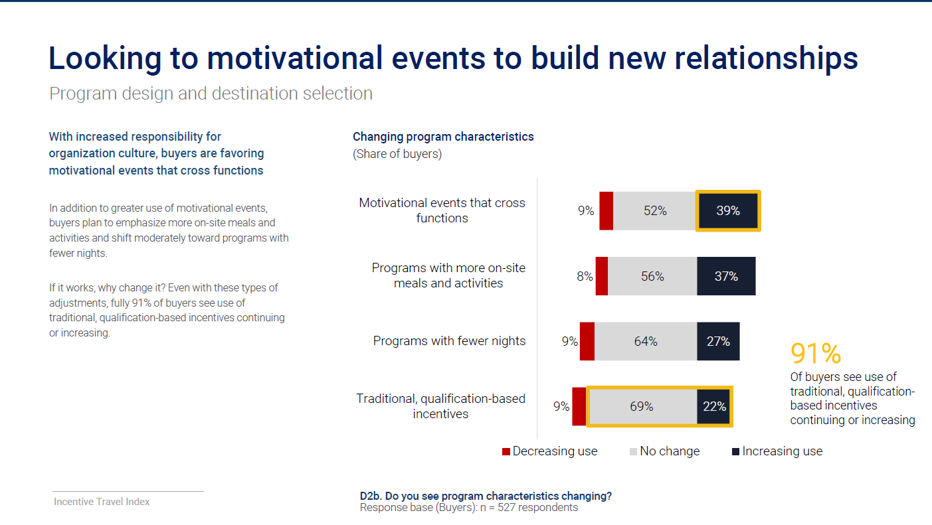
24
Source: Incentive Travel Index October 2022

Slide 25
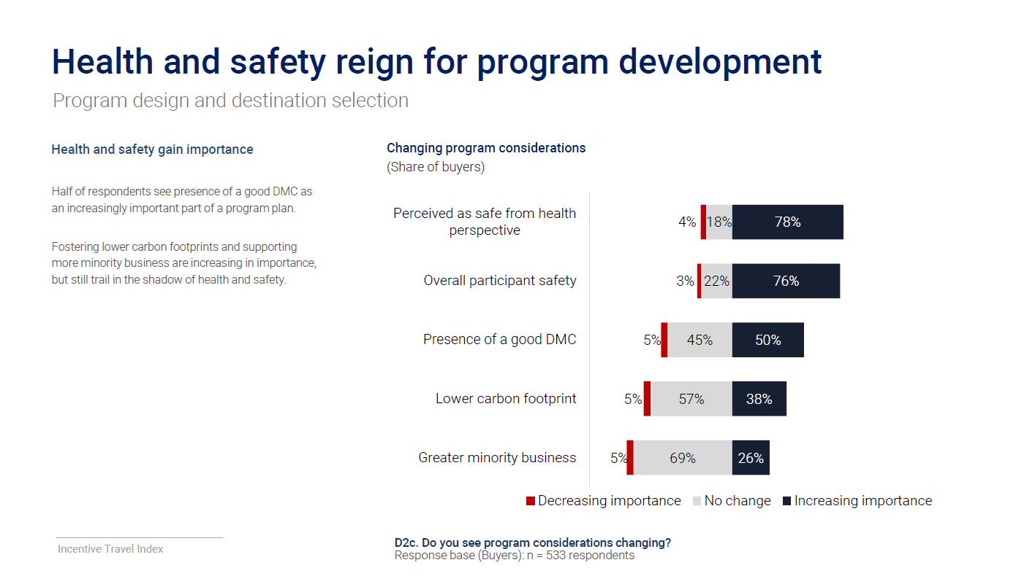
25
Source: Incentive Travel Index October 2022

Slide 26
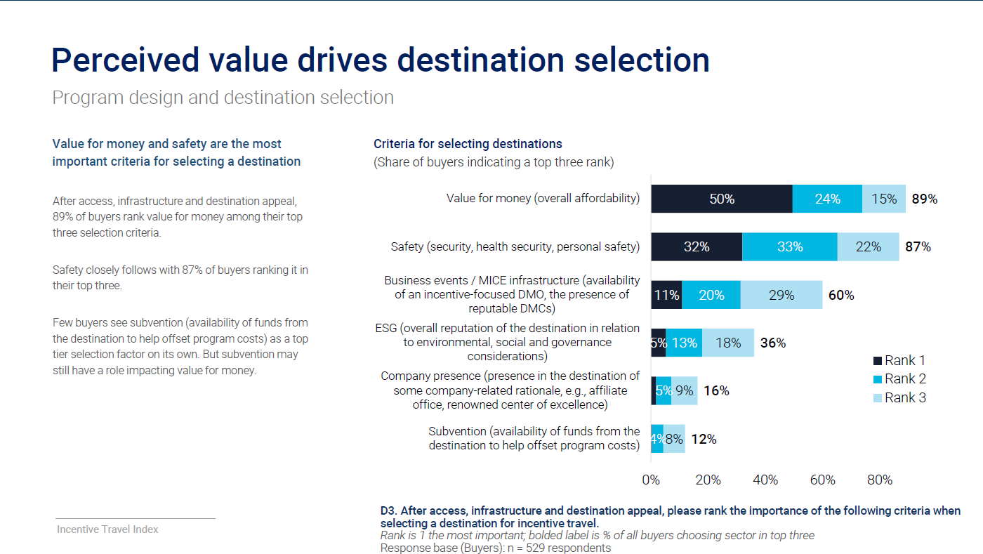
26
Source: Incentive Travel Index October 2022

Slide 27
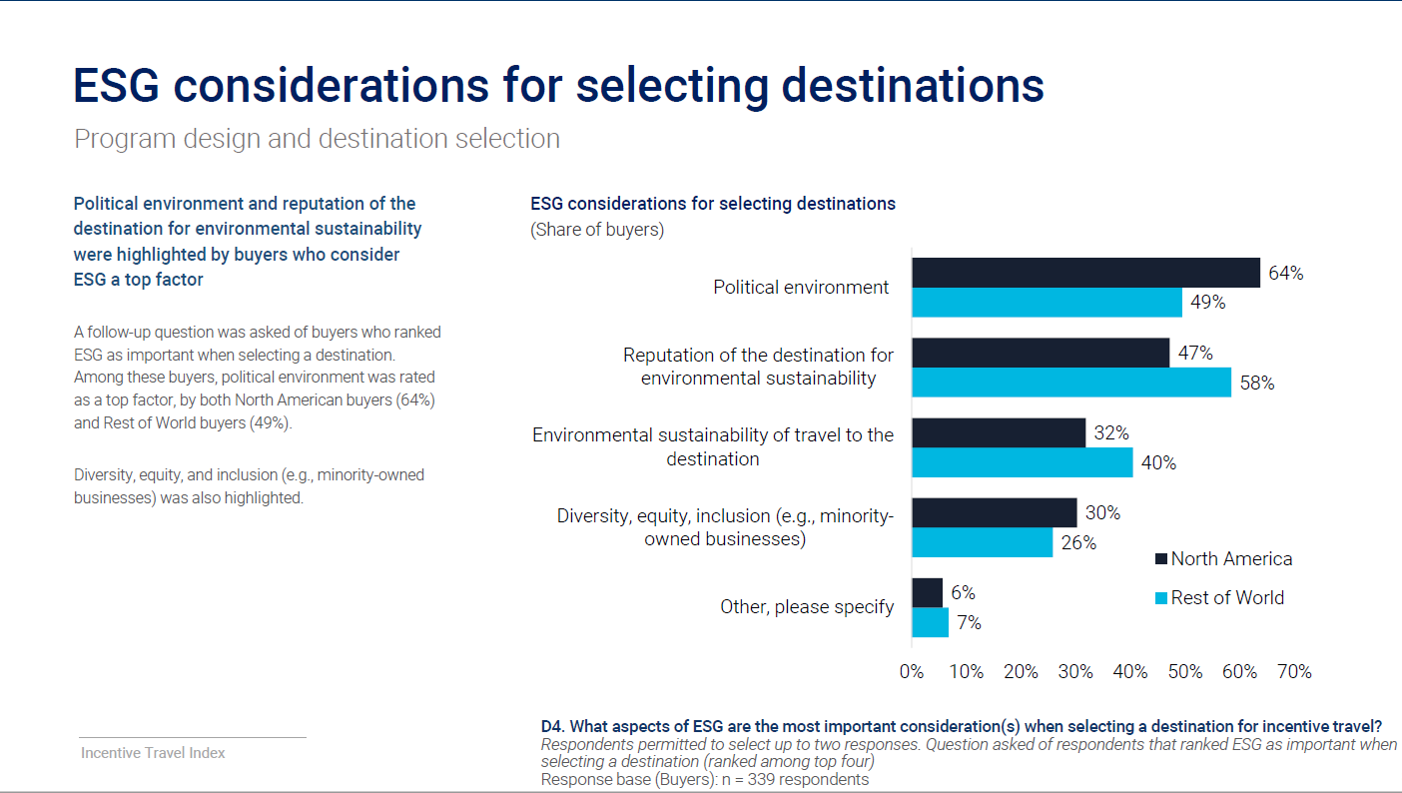
27
Source: Incentive Travel Index October 2022

Slide 28
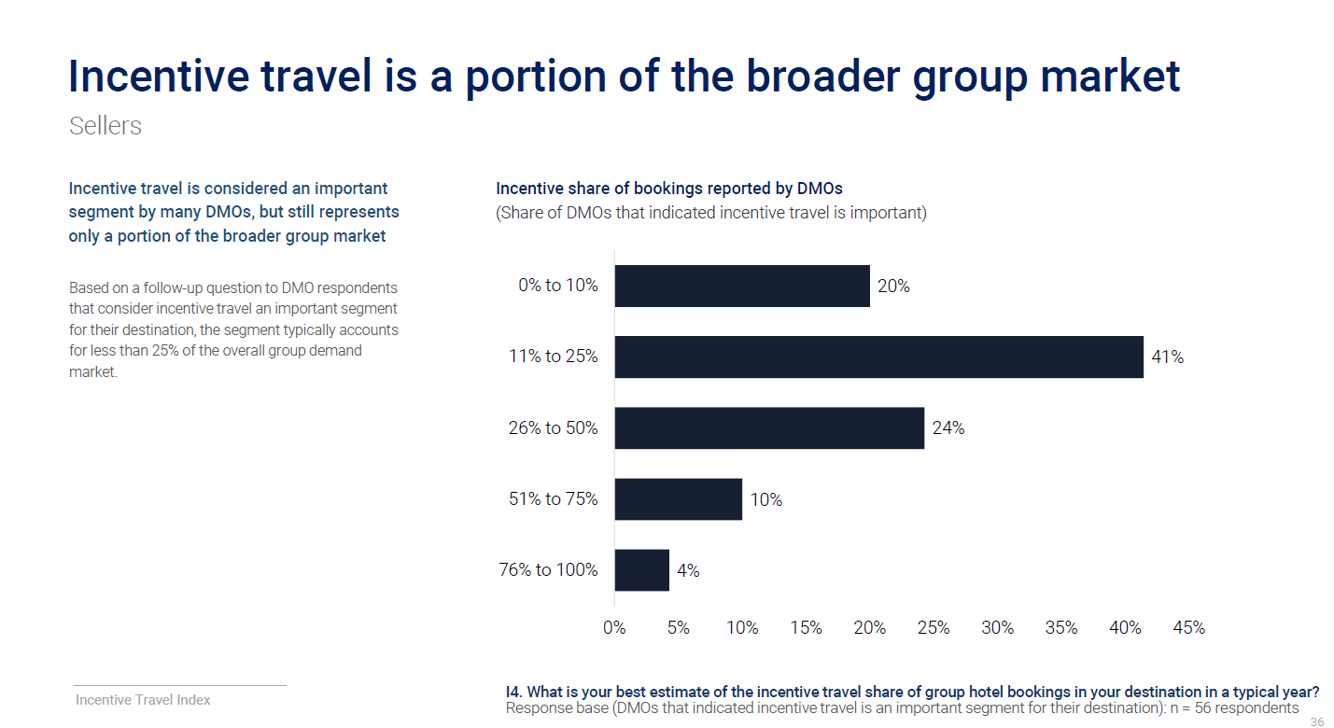
Incentive Travel is less than 25% of most sellers group business. How about yours?
28

Slide 29
Decision Drivers – Elevating the experience
29
In a separate F2F retreat, IRF gathered selected industry professionals in Canada for a roundtable discussion, here are the key takeaways;
Wellness is the new luxury.
Experience is far and away the biggest driver of destination choice.
Hotel’s, DMO, CVBs who can bring together critical elements will come out on top.
Participants are more demanding in terms of authenticity and wellness, and less in terms of programming to give room for downtime and optional activities.
Question: Do you agree/disagree with these takeaways?

Slide 30
Thank you
30
http://www.southeast-asia.com
Ooi Peng Ee | ooi.peng.ee@ttgasia.com
Head, TTG Global Commerce and Development
Publisher, Tourism Group (Maps and Guides)

