Slide 1


Slide 2
CUTTING EDGE
EVENT DESIGNS

Slide 3
WHO ARE
MKG EVENTS?
Sydney, Australia based Event Management & Marketing company.
Specialize in planning, marketing and managing successful events.
Corporate business conferences, charity galas, community and family events.
Online, in-person and hybrid events

Slide 4
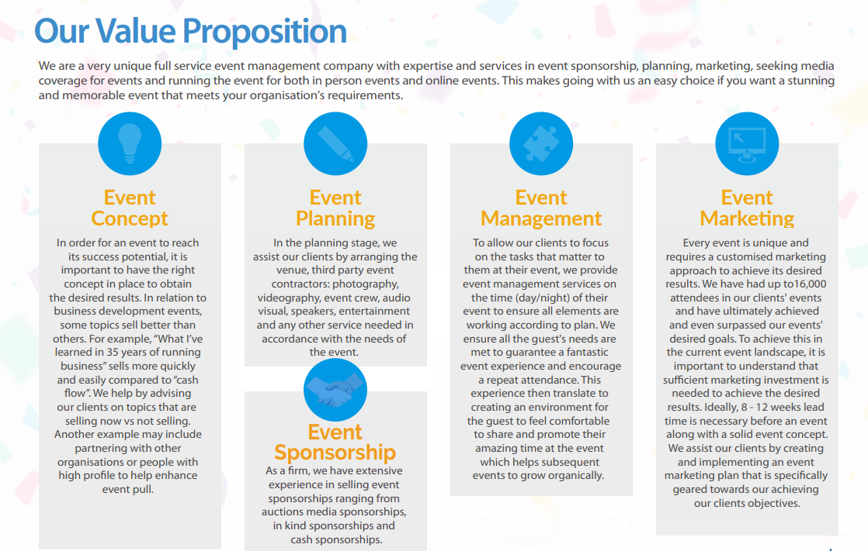

Slide 5
OUR
SUCCESS
Variety of clients, we bring significant insights on how to deliver a successful event
Secured more than 300,000 event attendees
Over 2 billion media impressions for client events
Up to 830% ROI

Slide 6
MKG ADAPTED!
15%-20% of Our
Clients STAYING ONLINE

Slide 7
CASE STUDY 1
Client expected 150 attendees.
We delivered 700 attendees.
CASE STUDY 2
Client expected 60 attendees.
We delivered 165 attendees.

Slide 8
OUR
EVENTS
Networking Events
Product Launches
Conferences & Coaching Events
Exhibitons
Gala Events

Slide 9
CASE STUDIES
SMALL TO MEDIUM
BUSINESSES

Slide 10
CASE STUDY
Anti Human Trafficking Charity
Increased more than
300% more in donations

Slide 11
EVENT PROMOTION
& MARKETING

Slide 12
EVENT
SPONSORSHIP

Slide 13
EVENT PRODUCTION
& EXECUTION

Slide 14
EVENT
FORMAT
How to Decide:
In-Person, Hybrid or Online

Slide 15
FUTURE PREDICTIONS
IMPACT EVENT DESIGN

Slide 16
SUSTAINABLE
EVENTS

Slide 17
CULTURALLY
SENSITIVE

