Slide 1
What’s Out and What’s in About Venue Designs
Amber Vanderburg
The Pathwayz Group

Slide 2
Welcome!
Answer the Questions Around the Room
Notes:
What is your favorite venue to see a show
Favorite platform to learn
Favorite thought leader
Reasons why people come to conferences/ events 1 most important 10 least important
Information
Pride/Connection
Level up CV
Meet SMEs
Learn about industry trends
Gain tools/vendors/resources
Travel
Name the MICE mouse on the screen
Have fun!
Note to Amber: play music
Find picture of mouse

Slide 3
Goals
Build Community in the Industry
Information
Connect with Others
Level up CV
Meet SMEs
Learn about industry trends
Gain tools/vendors/resources
Travel
Have fun!
Notes:
Debreif list from soft opening
Just like in a real univestity orientation, the goals of coming to an event, conference, or meeting at your venue is kind of similar

Slide 4
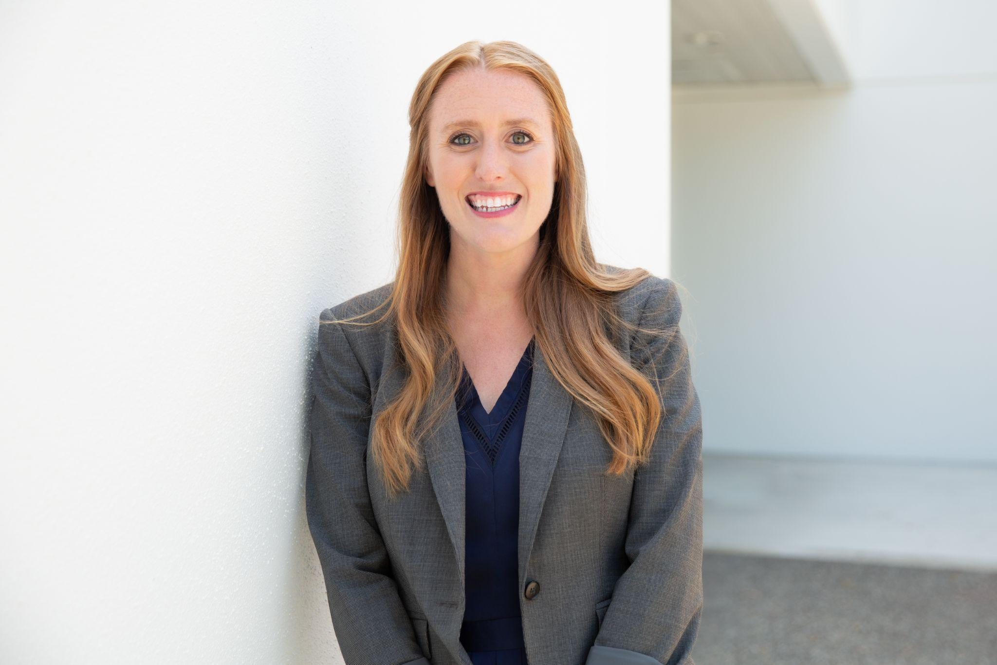
Hello! My name is Amber!
Notes:
Spoken in 30+ countries, more than 200 events, hosted event with my company across 9 countries. We are not an event company, my company The Pathwayz Group is a Learning and development company - so we create space to facilitate discussion, learning, understanding, and community - kind of like you so let’s take a look at your reasons to come to an event
Expectations for this session is to have facilitated conversation and share ideas

Slide 5
Build Community

Slide 6
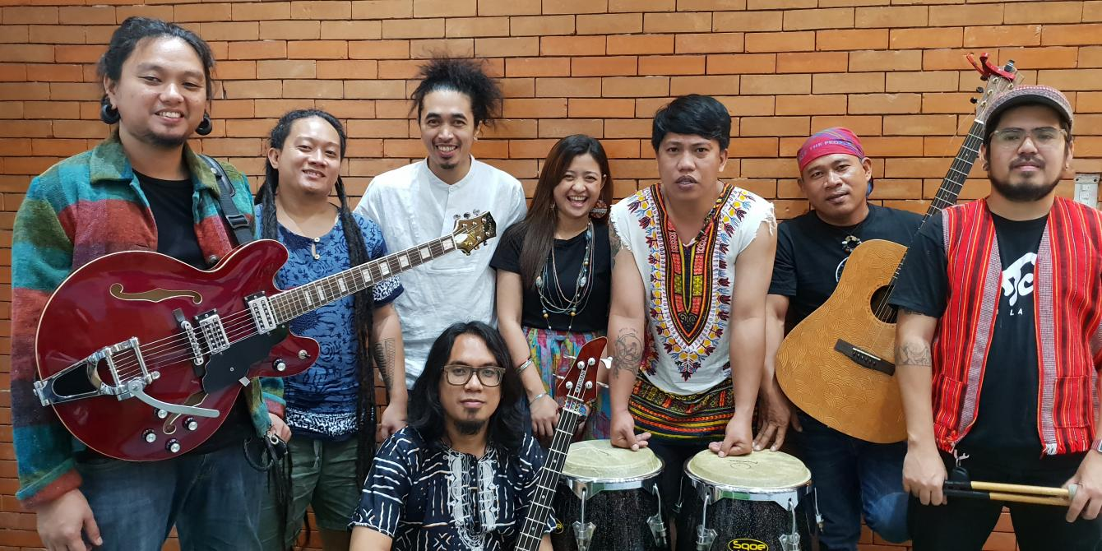
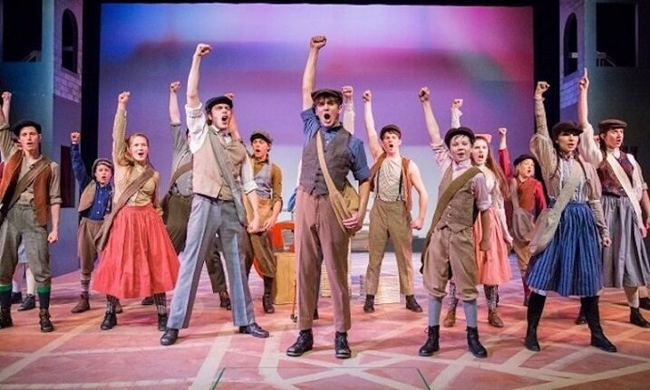
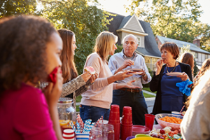

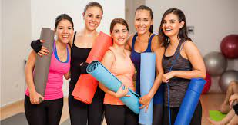

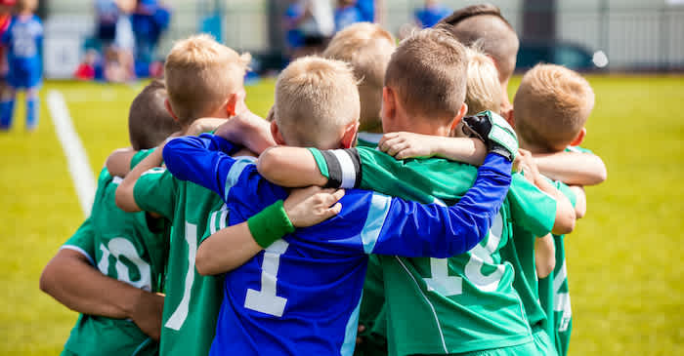
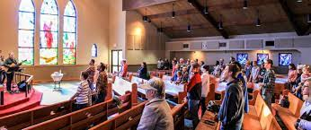
Community Groups
Notes:
Meet with your groups - create an exhaustive list of where you build community, where you find community, where do you feel the most connected
Debreif - what are some commonalities about the space in these places

Slide 7
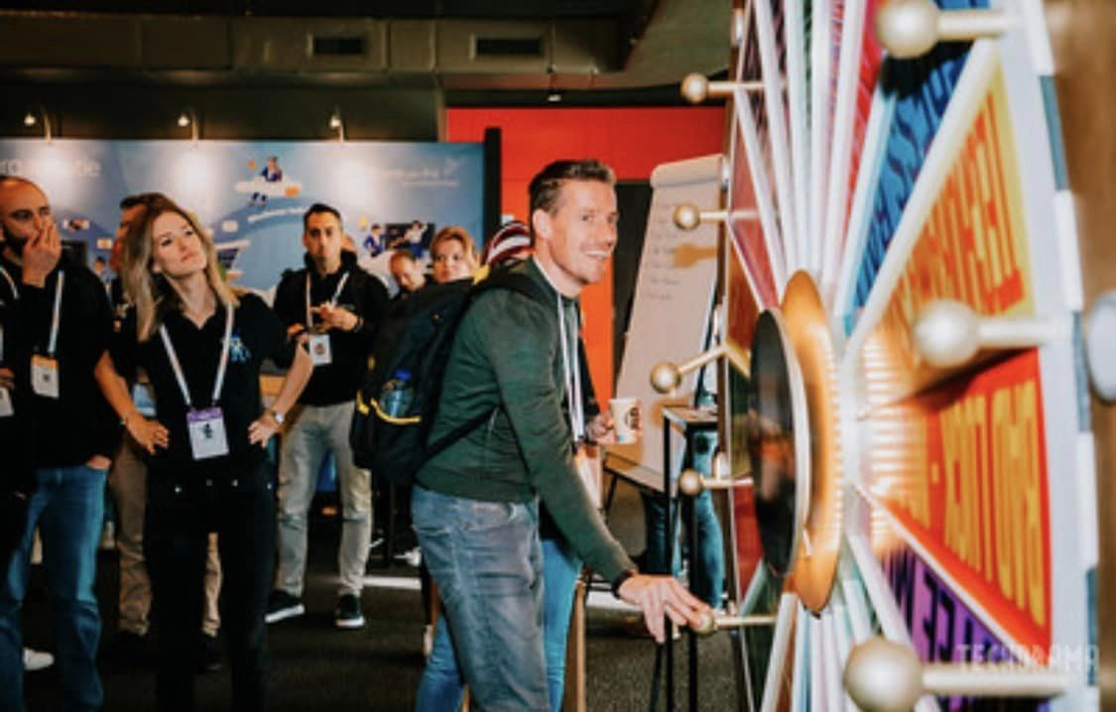
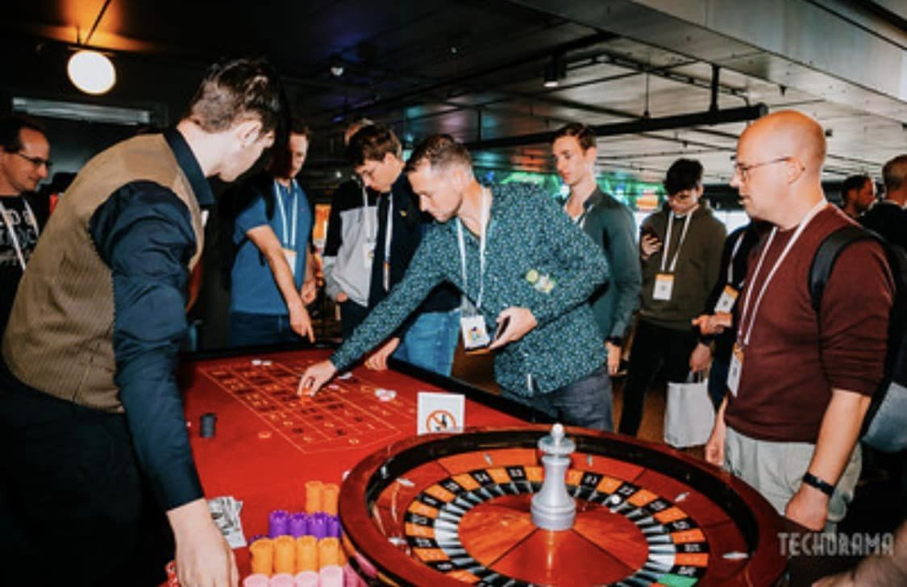
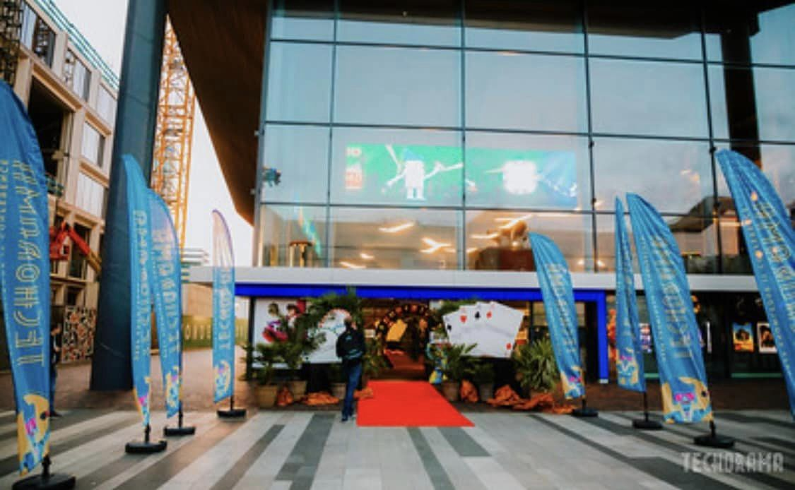
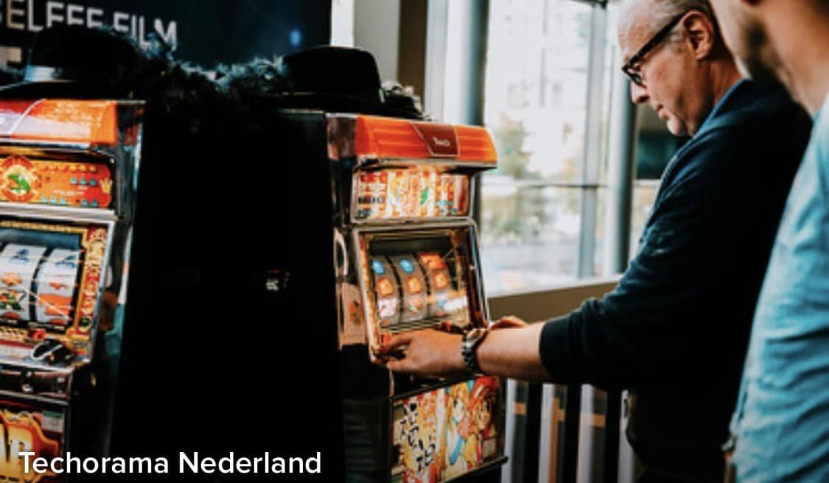
Build Community
Open Space (Time and Physical Space)
Environment (Nature, Tech, Music)
Food
Experiences
Notes:
We can cultivate community by the way we design our space -
Set the tone in our open space, environment
Food - this is critical
This is an example of, in my opinion, an excellent venue design - this was last year in Utrecht Netherlands - it was at an active motive theatre/event space
1. Set the tone on the outside - this could be a kiosk or sign balloons set the tone before you walk in the door
2. Experiences in the hallway - time to explore
3. Themes

Slide 8
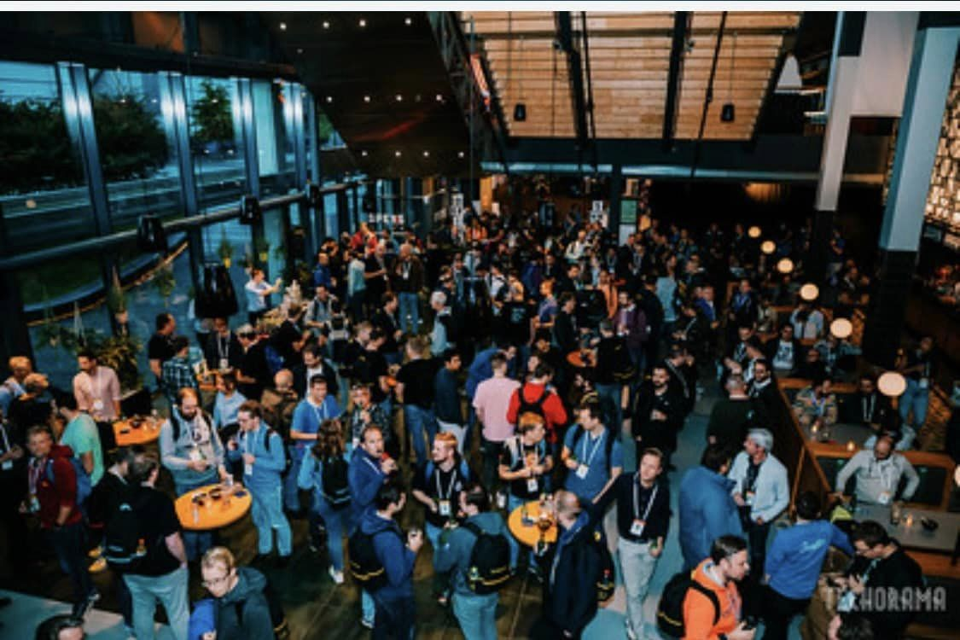
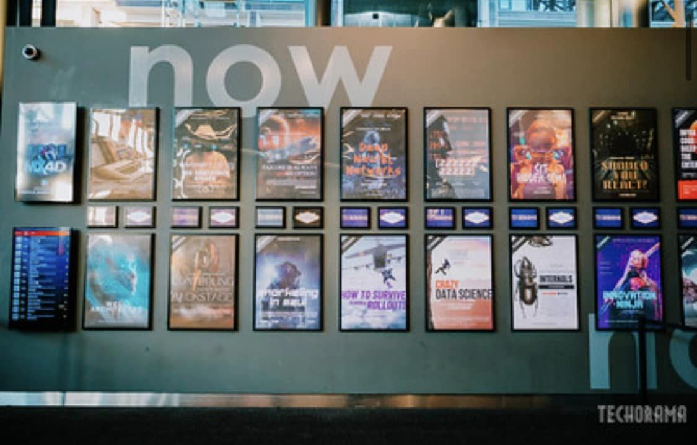
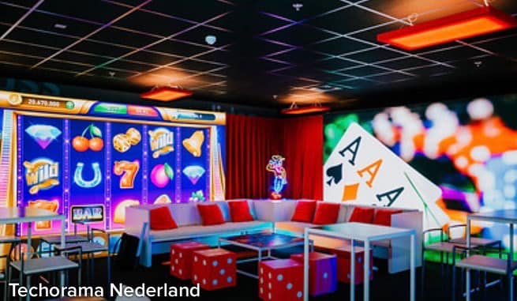
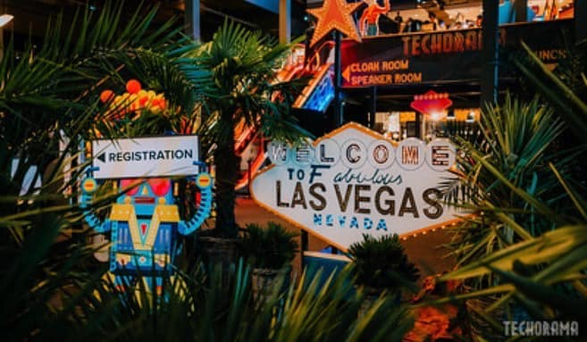
Notes:
Used the movie theatre to create posters of the presentations
Cafeteria style for food
Themed

Slide 9
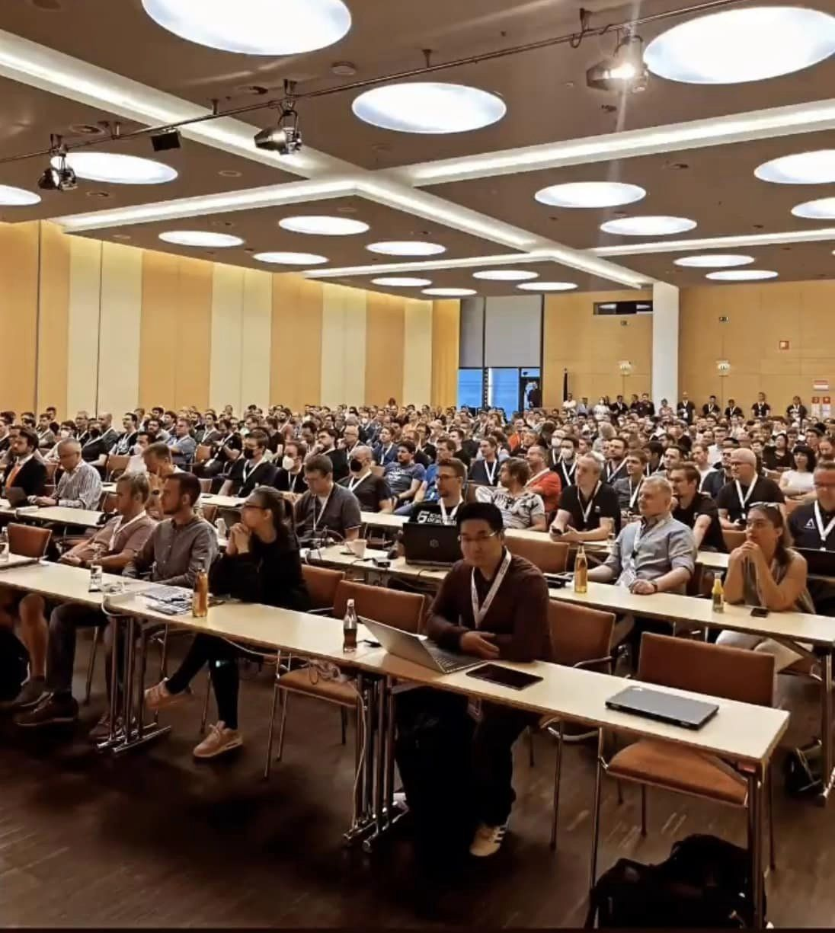
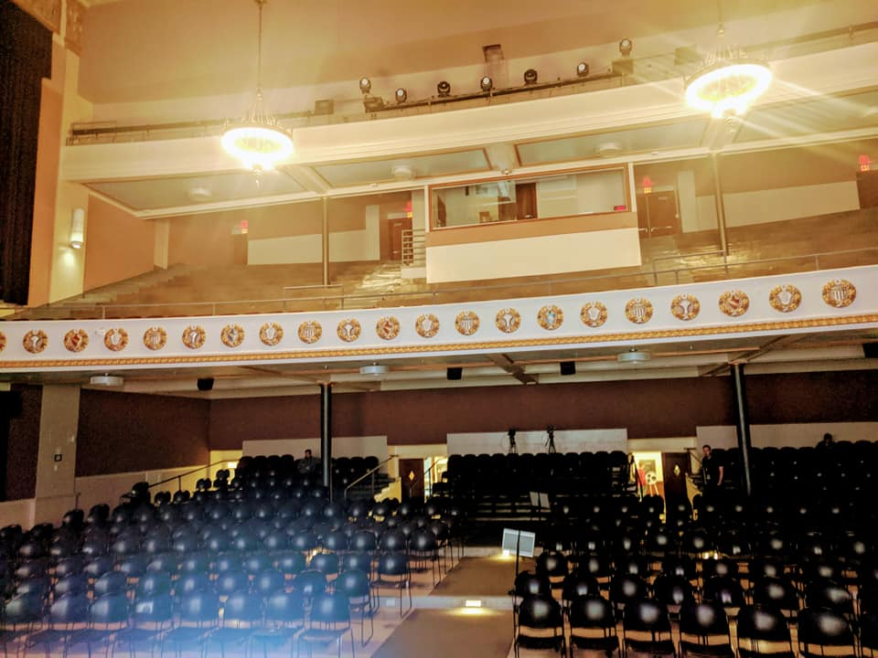
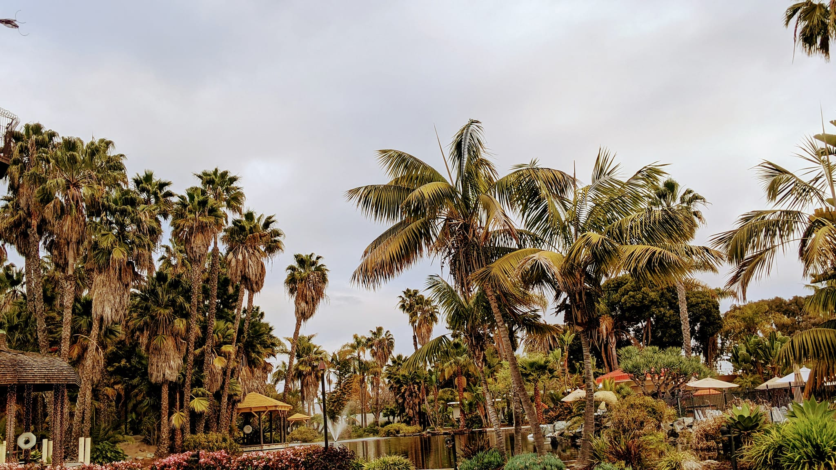
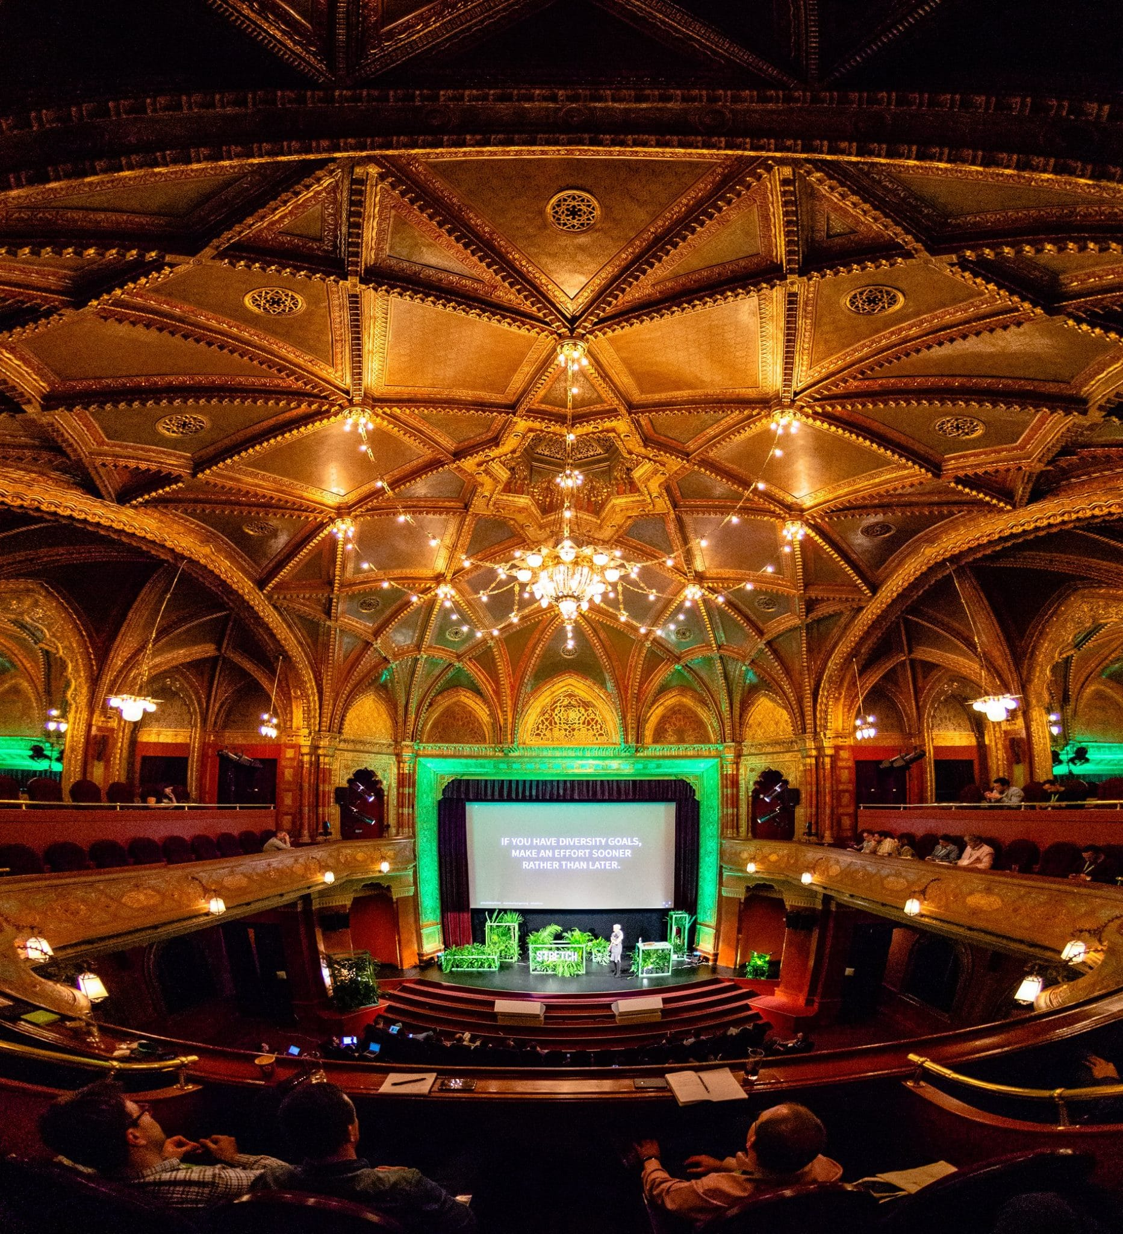
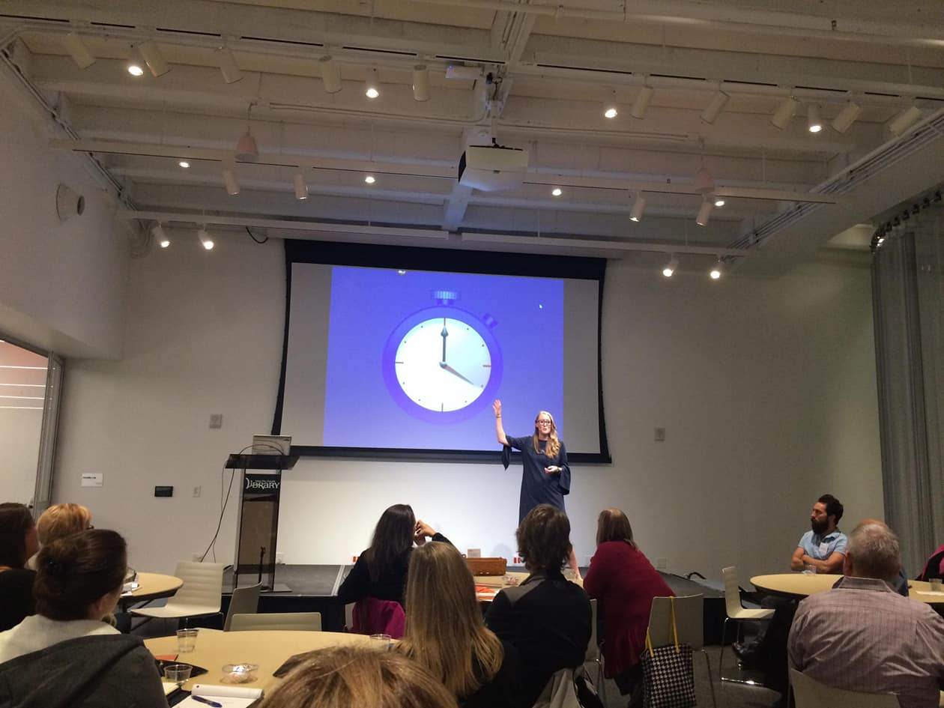
Space for Community
Notes:
Repurposed buildings and uses
Include picture of the acquarium
Try to keep this all in the same general space
Whats in - combining vacation and learning
What’s out - stiff, professional side

Slide 10
Creating Connections in Your Venue
Where do you naturally gather together?
Sitting Area
Food/ Water
Toilet
Trashcans
Aucustics

Slide 11
Multiple Floors
Have an open space
Clearly mark your map/ rooms

Slide 12
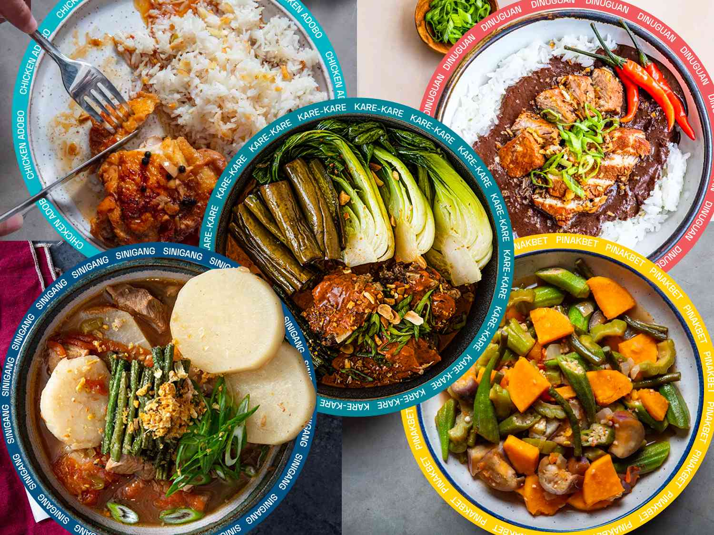
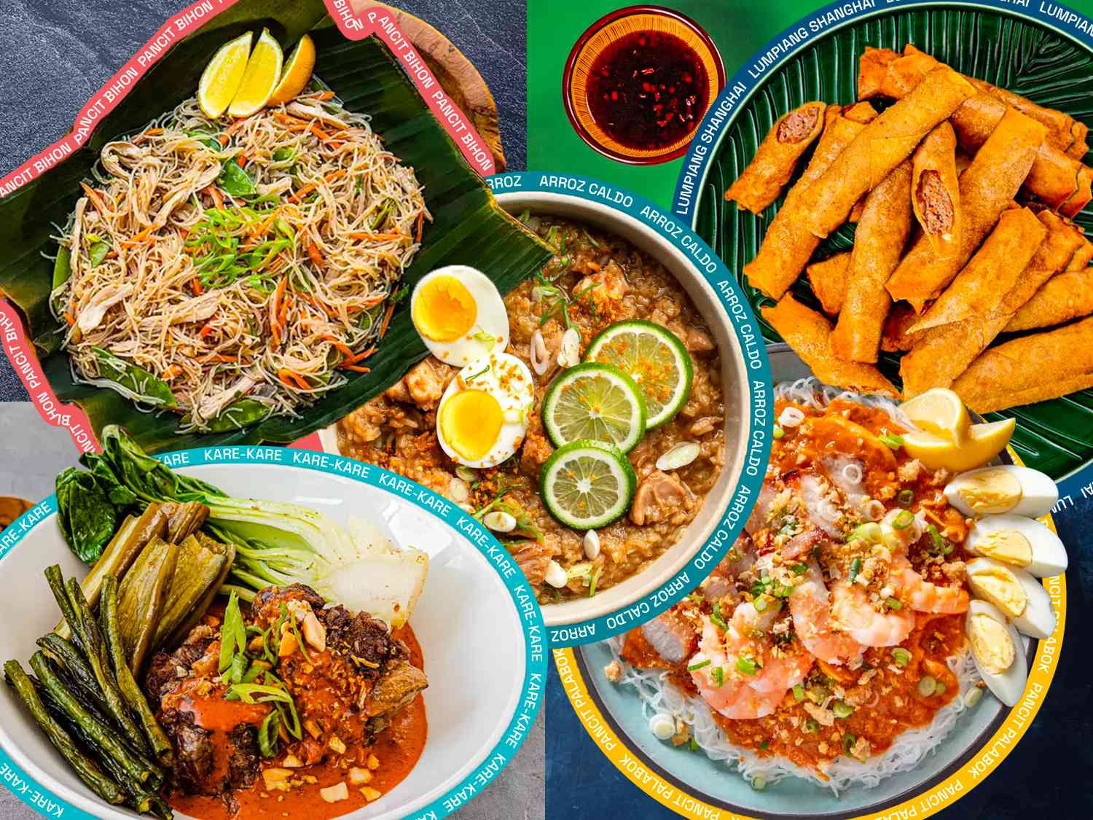
Food
Notes:
Spread out
Mixed in with Vendors
Snacks
Changing locations

Slide 13
Whats in Combining entertainment/connection and learning | What’s out Stiff, professional only Learning only

Slide 14
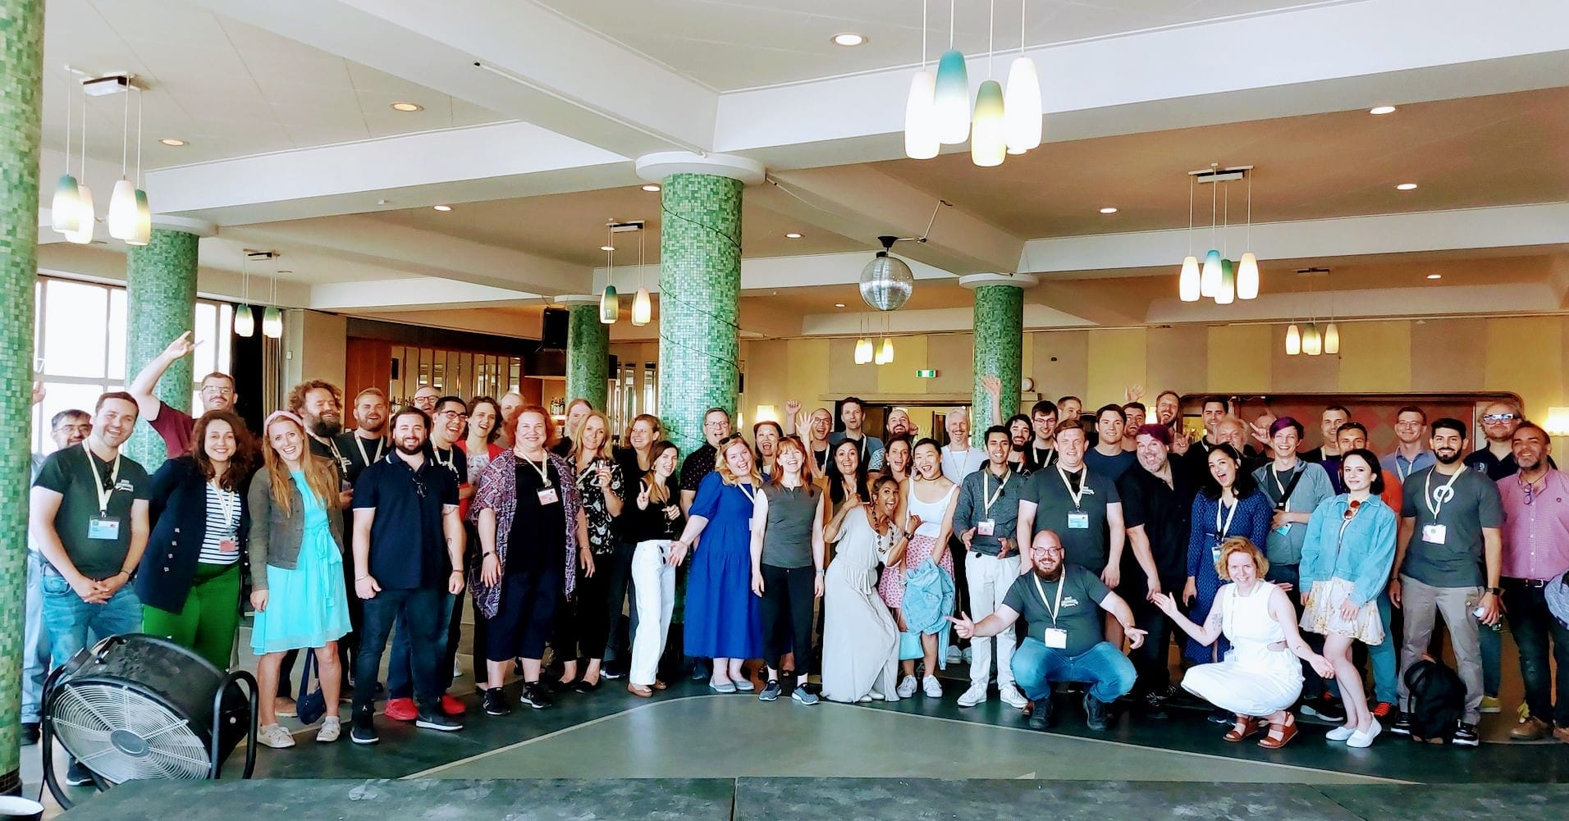
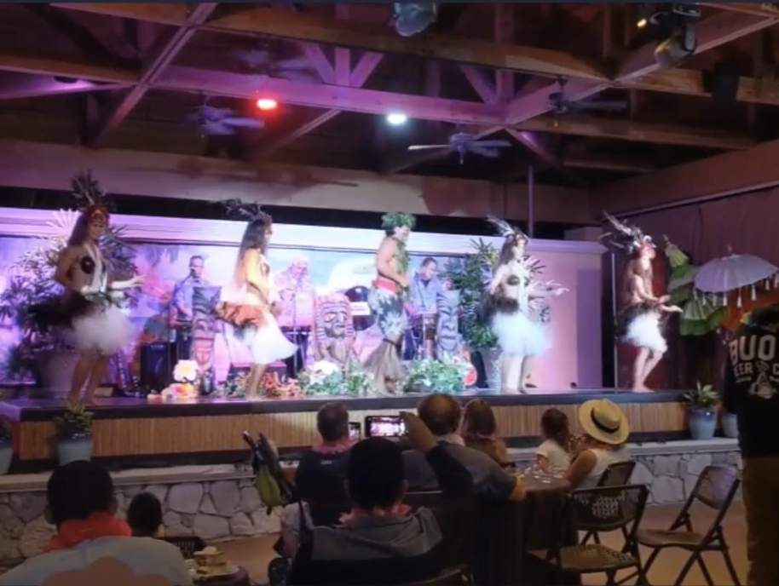
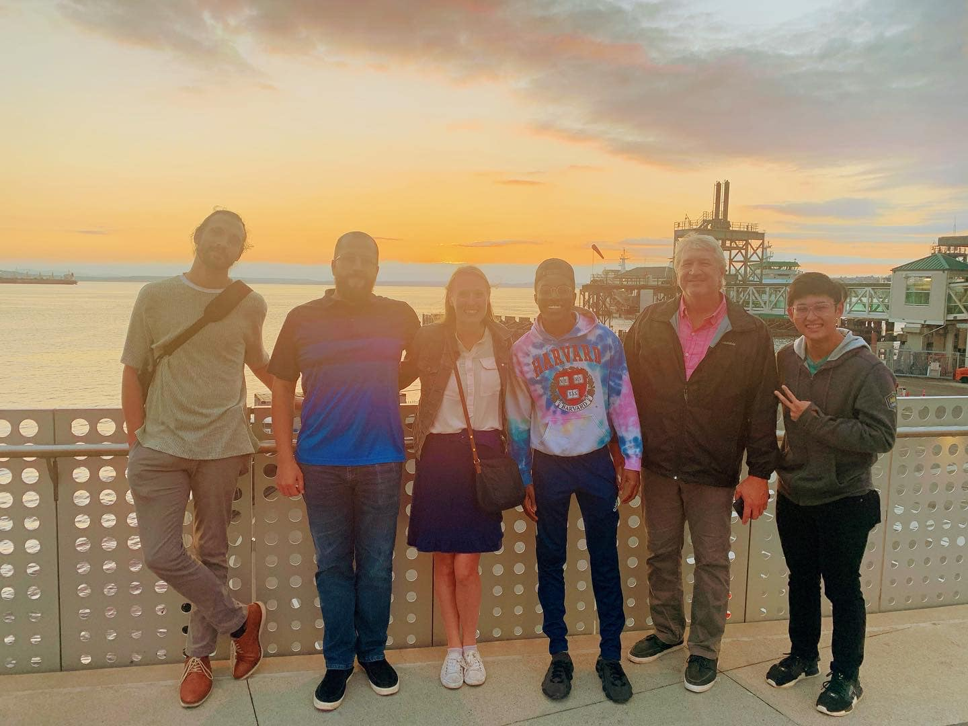
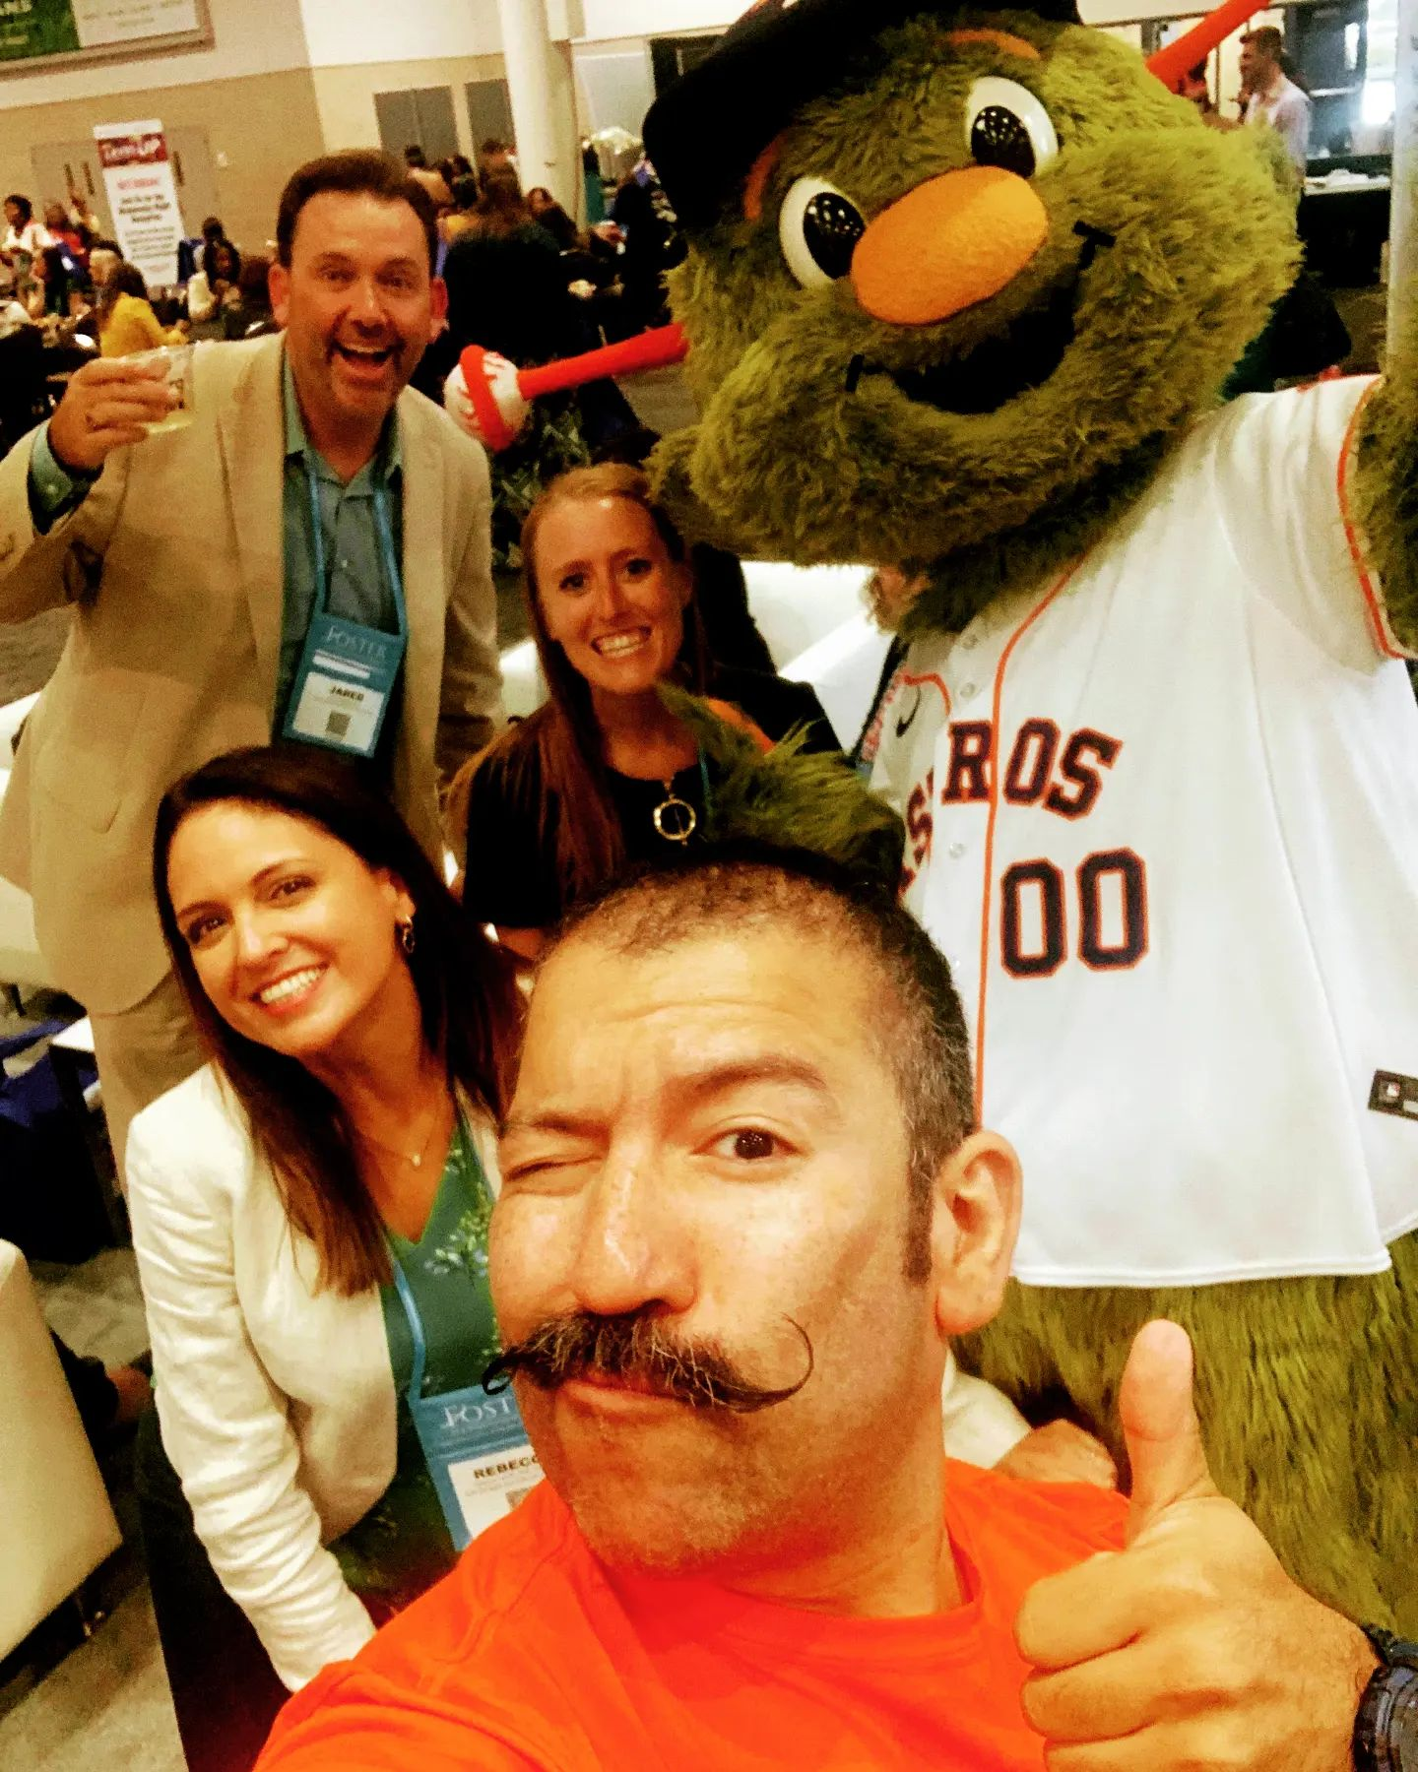
Connection Activities
Notes:
Hotels - host at the hotel
Especially post COVID, people are longing for connection, if I only wanted the information, I would have likely stayed home and watched online
Whats in - combining vacation and learning
What’s out - stiff, professional side -learning only get my credits
Ask - What activities have you done?

Slide 15
Connection Activities During the Conference
Pictures: Gamify the Conference
Puppy break / animal break
Dessert break/fondue
Games in the hallway track
Use the venue features
Music break/ art break
Notes:
Puppy break
Gamify vendors, posts, prizes, engagement online, attendance, questions
What’s in: Engagement

Slide 16

Notes:
That is not to say that all learning is out! Everyone has a piece of paper (activity)

Slide 17
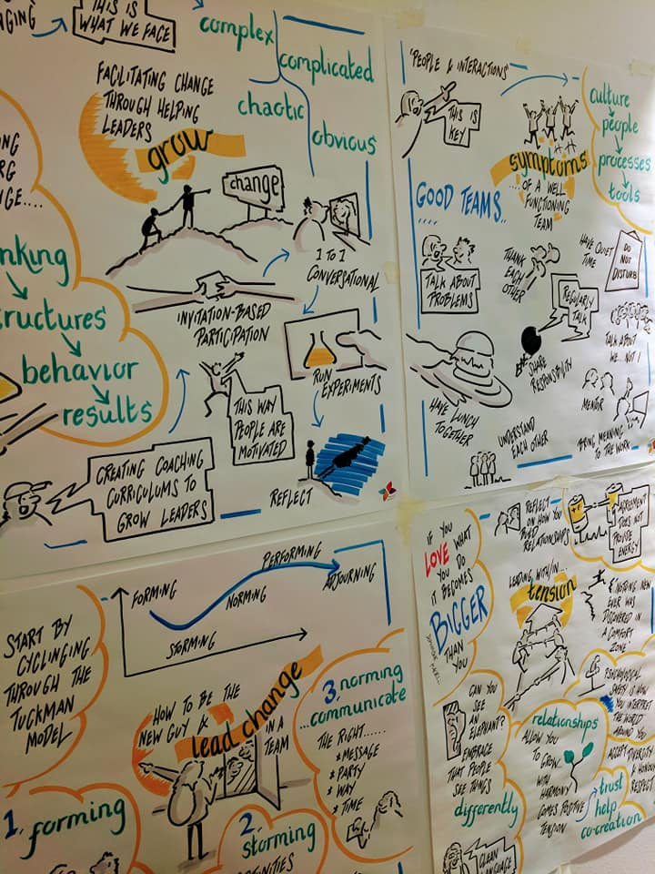
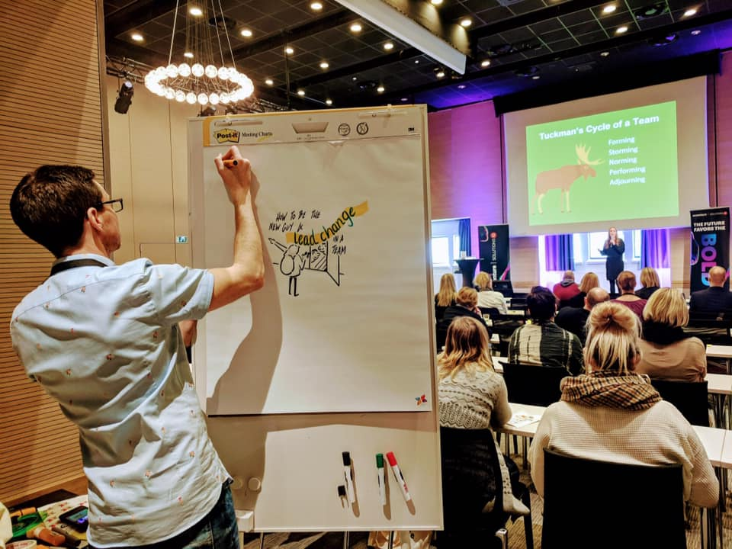
Sharing Information
Notes:
Also, apps for sharing information, summaries, having the same speaker go twice - I’ve seen these artists come in for corporate meetings as well - not only for events
Ask - in your groups, what other ways are you supporting the learning process of your attendees
What’s in: sharing information on multiple platforms in a variety of ways
Whats out: A single session without follow up

Slide 18
Whats in Sharing information on multiple platforms in a variety of ways | What’s out A single session

Slide 19
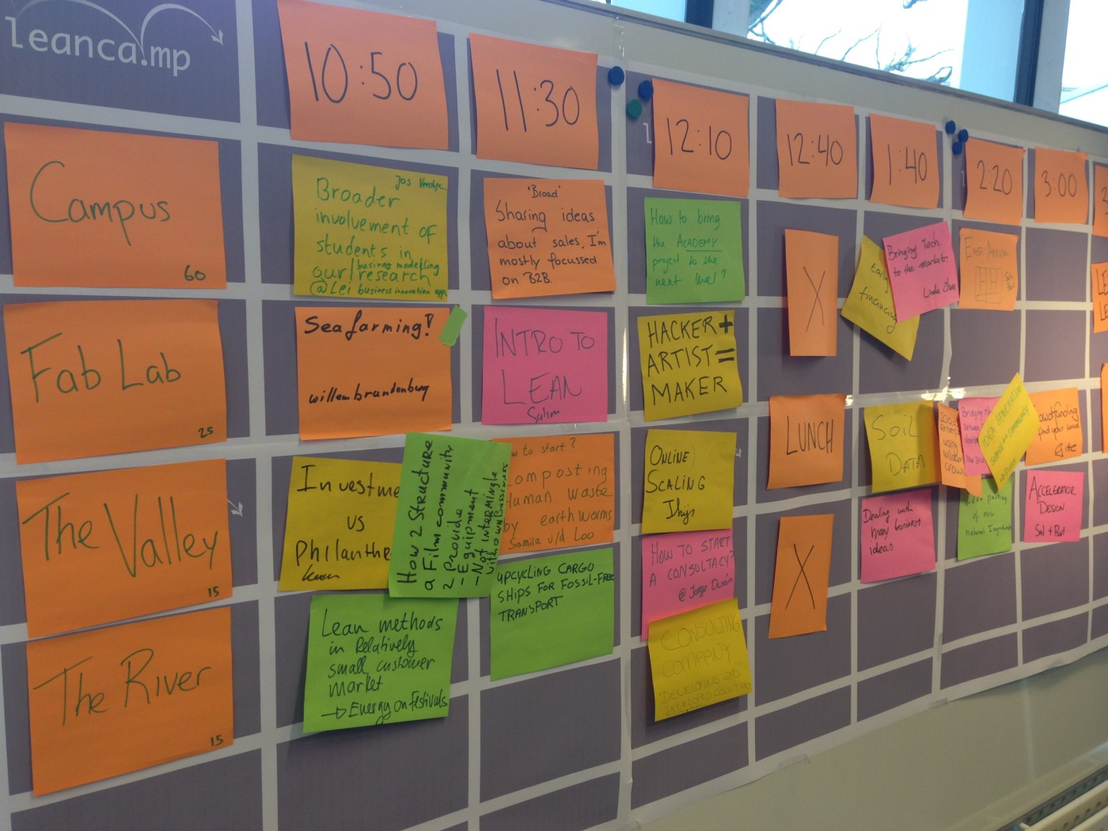
Sessions
Keynote
Workshops
Labs
Fireside chats
Unconference
Roundtables
Ignite Talks
Morning Pre conference
Speaker Table
Lunch/Dinner Chats
Vendors Related
Recorded / handouts
Online Discussion
Notes:
Speaking of sharing information in a variety of ways… sharing infomration in different formats is also a growing trend
What other delivery styles have you seen?
I would recommend a minimum of three formats - helpful if built upon
Whats in: Ownership and Variety of Delivery Formats
Whats out: A series of 1 hour sessions

Slide 20
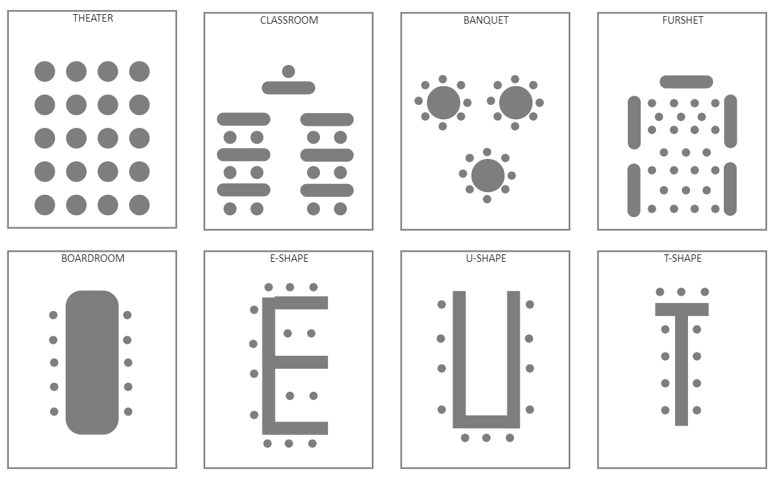
Notes:
Activity:
With your group, discuss your preferred method

Slide 21
Lessons from Nudge
Choice Archetect
Notes:
Include picture of book

Slide 22
Whats in Ownership and a Variety of Formats/Content | What’s out A series of 1 hour sessions only

Slide 23

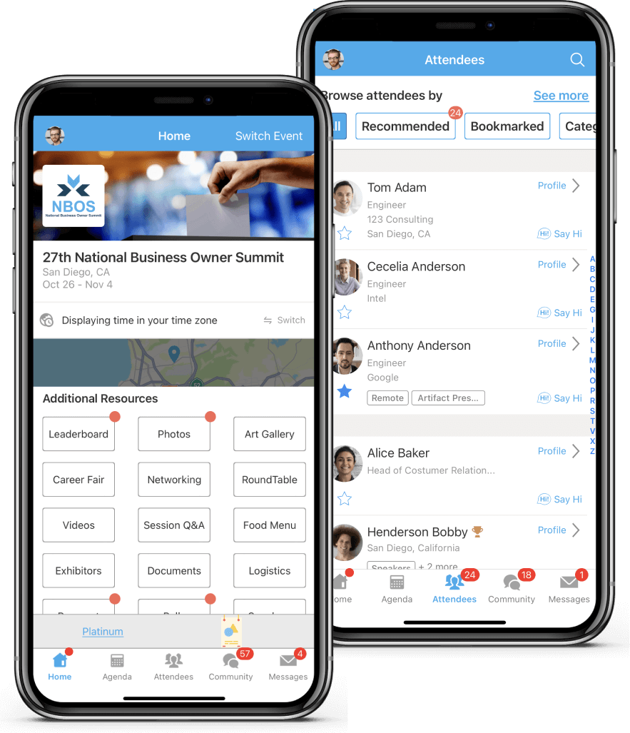
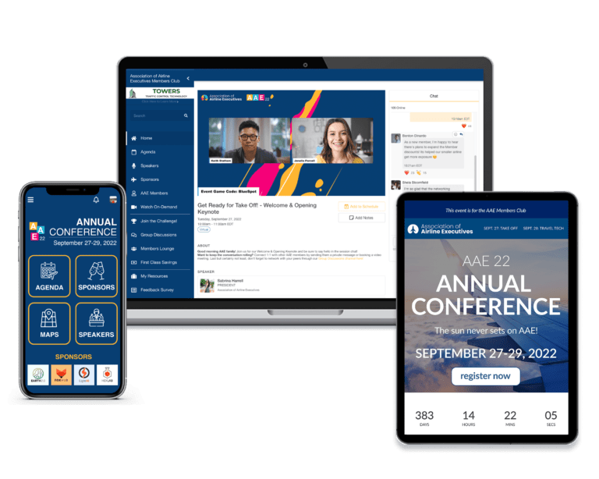

Venue Technology
Notes:
Whats in: Using technology alongside in person events
Whats out: Using tech only for online events

Slide 24
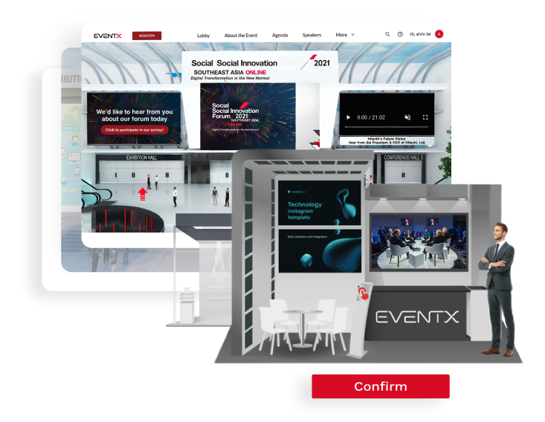
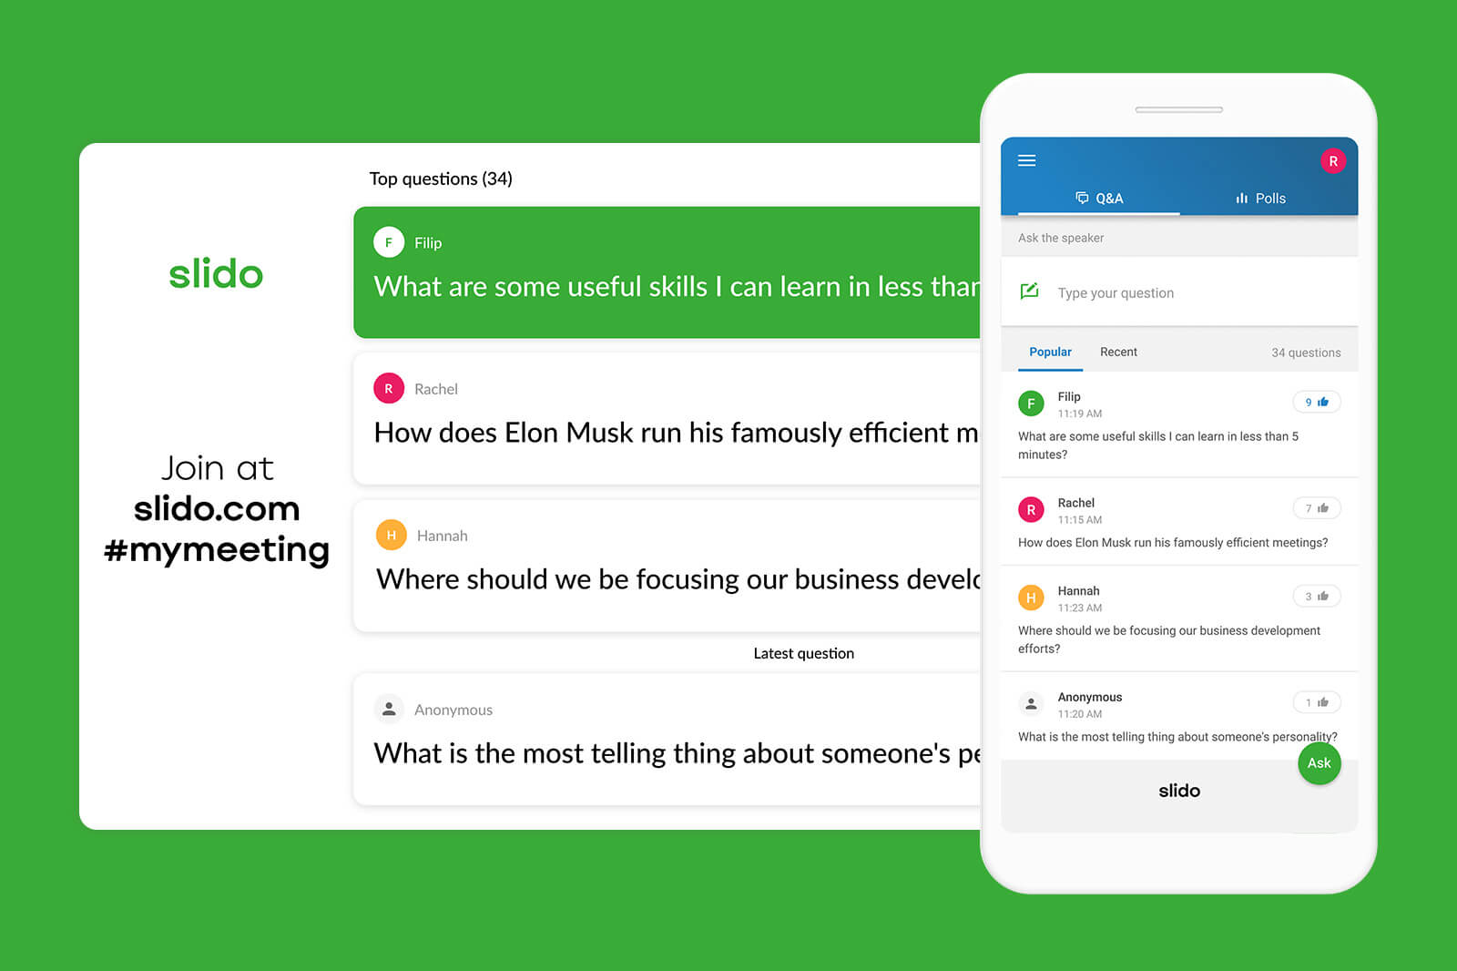


Notes:
Supported by Hauwei app and supports Chinese language

Slide 25
Notes:
What are some of the apps/ tech that you use to plan/engage in the event

Slide 26
Whats in Using apps alongside in person events | What’s out Using apps for only online events

Slide 27
Notes:
You are designing a venue for the international tea cup association - venue design ideas

Slide 28
Welcome!
Notes:
Lean on me activity

Slide 29
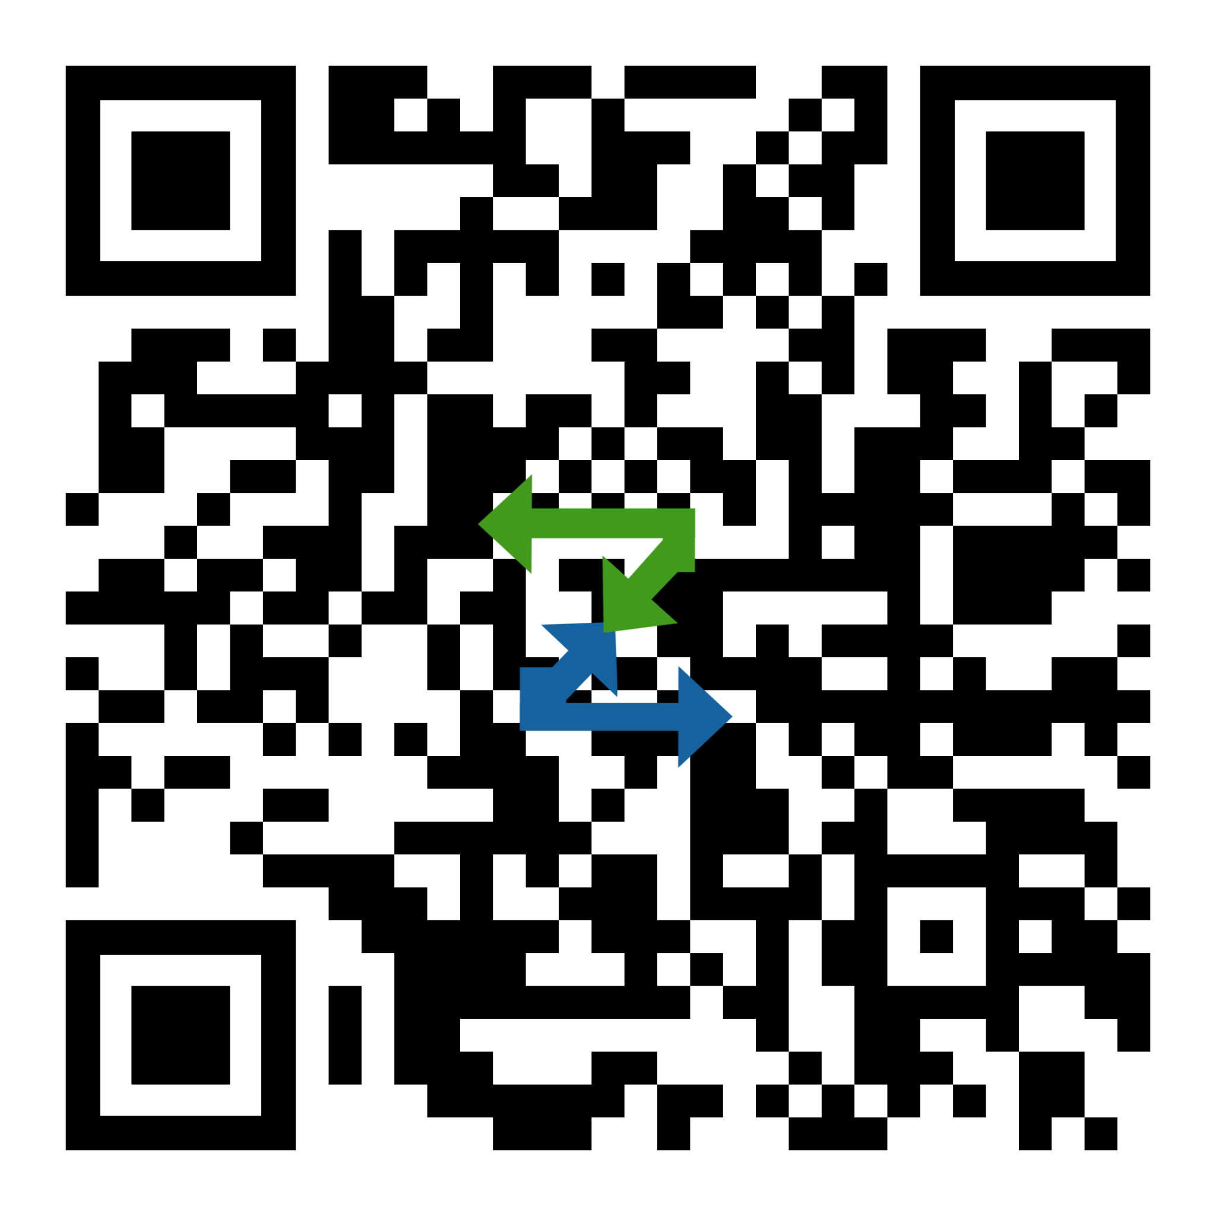
Let’s stay connected!
Amber Vanderburg
amber@thepathwayzgroup.com
@vanderburgamber
thepathwayzgroup.com
1-918-804-4982
Order Uniquely Better

Slide 30

Welcome to the University of MICE!

